Slide 1
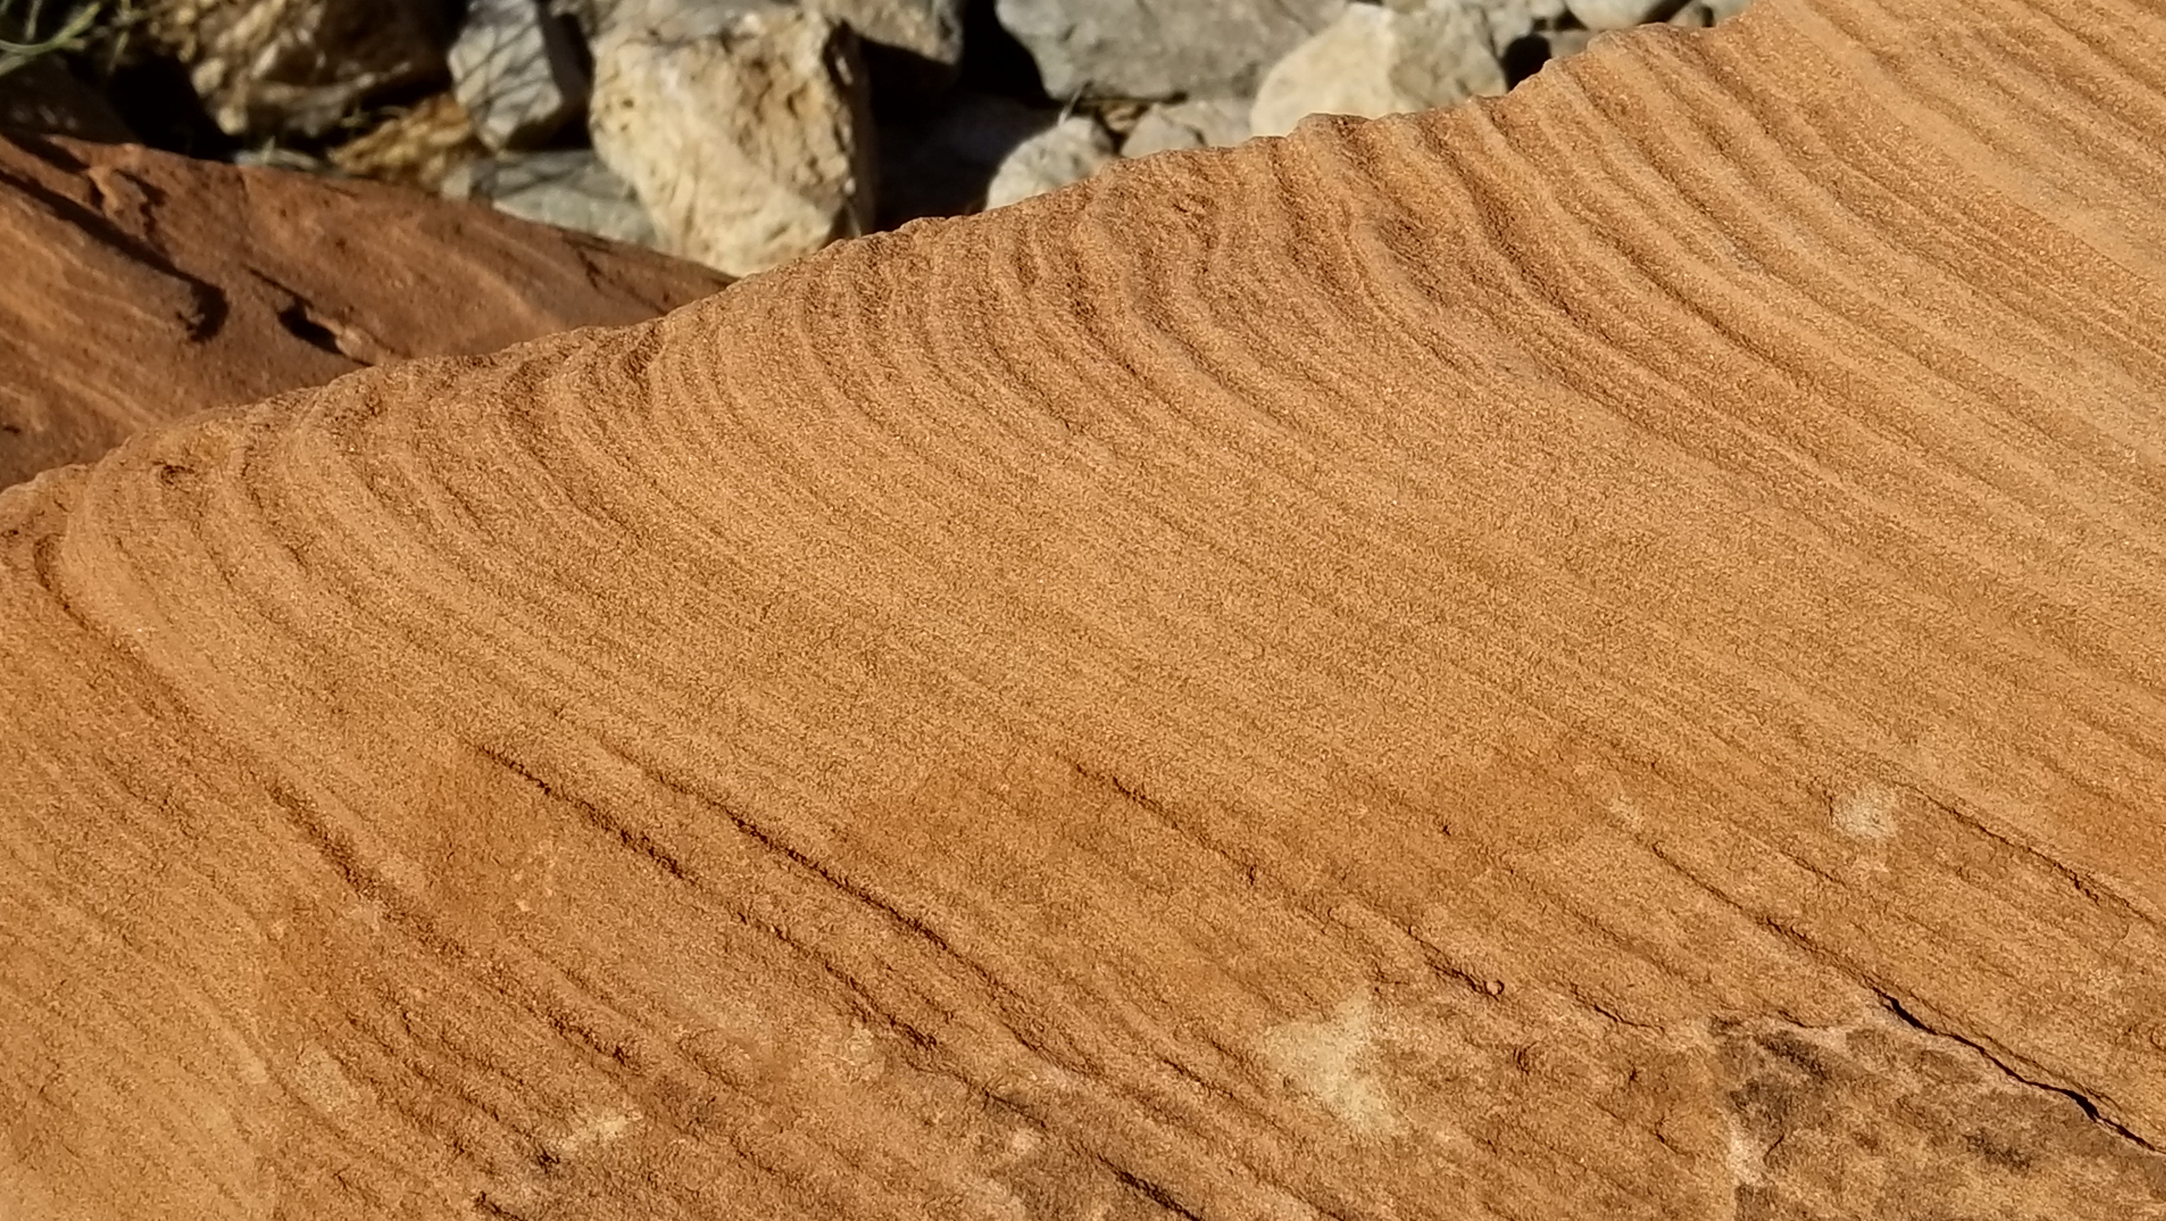
OBADIAH

Slide 2
#1
OBADIAH
Who wrote this prophecy?

Slide 3
#2
OBADIAH
Whom does the prophecy concern?

Slide 4
#3
OBADIAH
What would befall Edom and what would be the outcome?

Slide 5
#4
OBADIAH
What had pride done for Edom?

Slide 6
#5
OBADIAH
What was the source of Edom’s pride?

Slide 7
#6
OBADIAH
Would their position on the high ground protect them?

Slide 8
#7
OBADIAH
How were Edom’s “hidden treasures” compared?

Slide 9
#8
OBADIAH
Could the Edomites rely on their allies?

Slide 10
#9
OBADIAH
Could they rely on their academics?

Slide 11
#10
OBADIAH
Could they rely on their military might?

Slide 12
#11
OBADIAH
Why was God planning Edom’s punishment?

Slide 13
#12
OBADIAH
How was that sin manifested?

Slide 14
#13
OBADIAH
Summarize the “reprisal” upon Edom?

Slide 15
#14
OBADIAH
How would the house of Jacob be fire while the house of Esau would be stubble?

Slide 16
#15
OBADIAH
With whom would the house of Jacob burn the house of Esau?

Slide 17
#16
OBADIAH
In what sense would “the mountains of Esau” and many other lands be possessed?

Slide 18
#17
OBADIAH
Identify the “saviors” who would ascend Zion.

