Slide 1
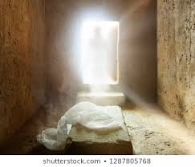
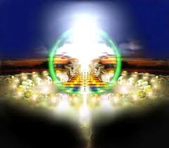
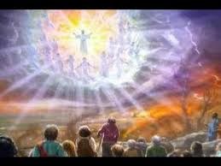

Christ has Risen
Christ is Reigning
Christ is Returning
Certainties Concerning Christ
(1 Cor. 15: 1-28)

Slide 2
I. Christ Has Risen
1 Cor. 15:20 (Had indeed been raised)
Matt. 16:21; 17:22-23; 20:17-19 (Subject of His teachings)
Rom. 1:1-4; 1 Cor. 15:1-4; 12-20 (Subject of Apostle teachings)
1 Cor. 15:1-11; Acts 1:1-3 (Eyewitness testimony)

Slide 3
Christ Has Risen (Theories Concerning the Resurrection)
Body was stolen?
a. Jn. 20:19 (Disciples were in hiding)
II. Swooned away?
a. Jn. 19:31-37 (Record is True)
Women went to the wrong tomb?
a. Matt. 27-62-66 (Sealed and had a watch)
b. Matt. 28: 1-6 (Angel sitting at the tomb)

Slide 4
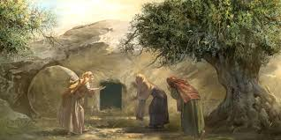
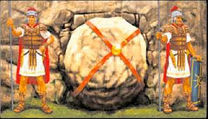
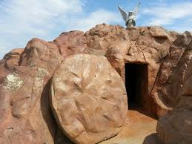
Wrong Tomb?
Wrong Tomb?
Wrong Tomb?

Slide 5
II. Christ Is Reigning
1 Cor. 15:25-26 (REIGN UNTIL ALL ENEMIES UNDER HIS FEET)
Lk. 1:26, 30-33 (Announcement)
Acts 2:29-36 (WHEN DID HE BEGIN HIS REIGN)
Jn. 18:36 (Spiritual Kingdom)
Mk. 9:1; COL. 1:12-13; REV 1:9; 1 Cor. 15:24 (Kingdom is NOW)

Slide 6
III. Christ Is Returning
Acts 2:14-18 (last days began at Pentecost)
Jn. 6:39-40,44,54 (Resurrection promised on the last day)
Jn. 5:28-29 (Resurrection of good and evil)
Jn. 12:48; 2 Cor. 5:10; Rom. 14:10 (Judgement)

Slide 7
Christ has Risen
Christ is Reigning
Christ is Returning
Christ has risen. The foundation of our salvation and hope.
Christ is reigning. He rules now, and we are His subjects.
Christ is returning. When He comes, the end will arrive, and eternity will begin.

Slide 8
Here is what God calls us to do:
Hear the word (Rom. 10:17).
Believe in Christ (John 8:24).
Repent of sins (Luke 13:3).
Confess His name (Matt. 10:32-33; Rom. 10:9-10).
Be baptized into Christ (Mark 16:16; Rom. 6:3-5; Col. 2:12 gal. 3:26-27).
Live faithfully until death (1 COR. 15:58; Rev. 2:10).
Christ has risen, Christ is reigning, and Christ is returning.
The only question left is this: Will you be ready when He comes?

Slide 9
Christ has Risen
Christ is Reigning
Christ is Returning
Certainties Concerning Christ
(1 Cor. 15: 1-28)

