Slide 1
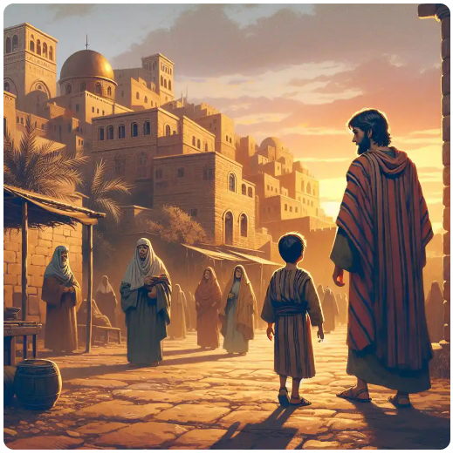
GOING HOME WITHOUT JESUS
(Luke 2:40-52)

Slide 2
Jesus the Lost One (vs 43-44)
Matthew 10:37
Isaiah 34:16
Mark 7:5-9;13
2 Peter 1:10
1 John 5:13

Slide 3
II. Jesus the Searched One(vs 45)
Jeremiah 29:13
John 5:36-39
Acts 17:10-11
Matthew 7:7-8
Hebrews 11:6

Slide 4
III. Jesus the Found One (vs 46)
Luke 20:1
Luke 21:37-38
John 7:14
John 8:1-2
2 John 1:9

Slide 5
GOING BACK TO JERUSALEM
(Luke 2:45)

Slide 6
IV. To Find the Lord’s Church
Matthew 16:13-19
Matthew 17:1-5
Acts 20:28
Luke 24:44-47

Slide 7
V. To Find the Lord’s People
Acts 11:25-26
Acts 26:27-28
1 Peter 4:15-16

Slide 8
Romans 10:17
John 8:24
Luke 13:3
Romans 10:9-10
Mark 16:15-16; Acts 2:38

