Slide 1
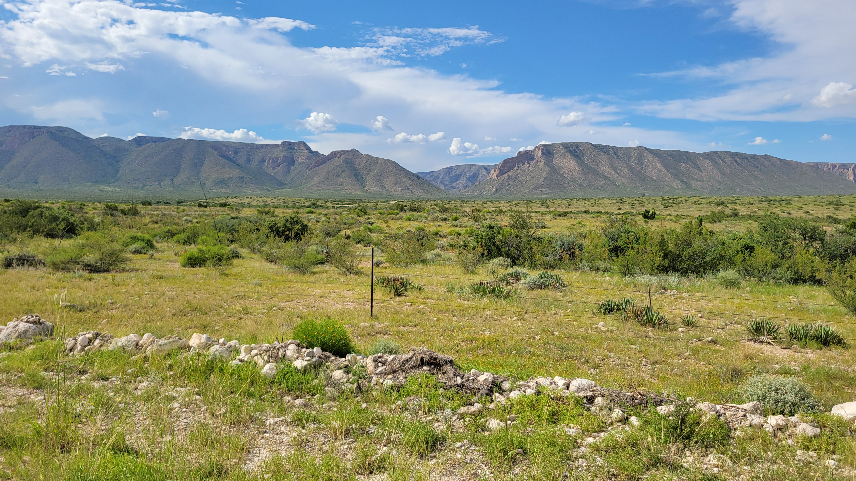
Martha Meeting the Messiah

Slide 2
Martha Meeting the Messiah
Luke 10:38-42

Slide 3
Martha Meeting the Messiah
“Martha Welcomed Him Into Her House”
Luke 9:58
Luke 10:38
Matthew 25:31-46
Hebrews 13:2
Acts 2:46
Romans 12:13

Slide 4
Martha Meeting the Messiah
“Martha Was Distracted”
Luke 10:40
1st Peter 4:9
John 6:27;
2nd Thessalonians 3:10
John 12:1-2
Proverbs 9:8-9
Luke 12:29-31

Slide 5
Martha Meeting the Messiah
“My Brother Would Not Have Died”
John 11:1-22
John 5:36; Acts 2:22
John 11:41-42

Slide 6
Martha Meeting the Messiah
“I Believe that You Are the Christ”
John 11:23-27
Luke 4:41; John 1:40-41, 47-49; 4:25-26; 6:68-69; 9:35-38
1st John 4:15
Luke 6:46-49

