Slide 1
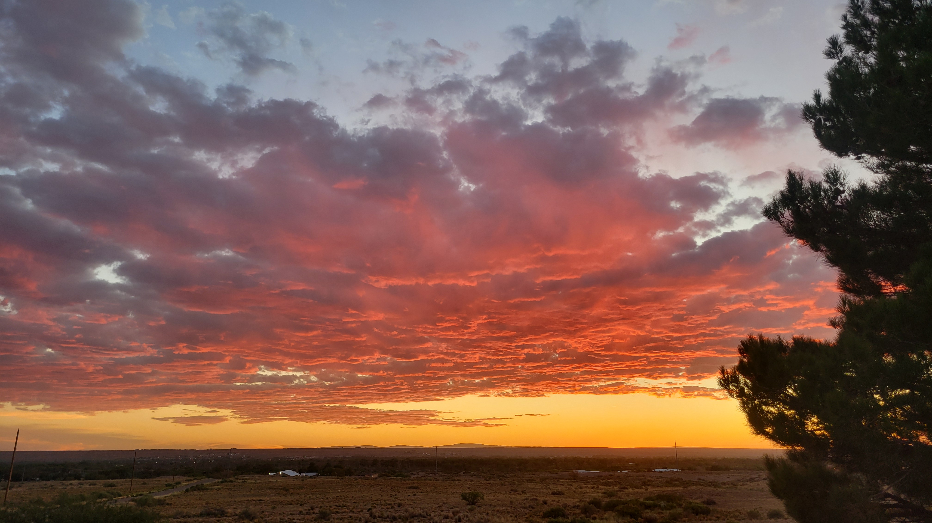
MESSIANIC MILESTONES
The Childhood of the Messiah

Slide 2
THE CHILDHOOD OF THE MESSIAH
He Was Worshiped By Magi
Matthew 2:1-12
Acts 13:6-8
Daniel 2:45-48, 2, 24
Daniel 5:11-12; 4:37; 6:25-28
Daniel 2:44; 9:25
Genesis 1:14; Revelation 22:16
Ezra 7:8-9

Slide 3
THE CHILDHOOD OF THE MESSIAH
He Was the Target of an Infanticidal Massacre
Matthew 2:13-18
Exodus 1:22-2:10
Deuteronomy 18:15; Acts 3:22; 7:37
Hosea 11:1; Jeremiah 31:15

Slide 4
THE CHILDHOOD OF THE MESSIAH
He Was Raised Worshiping
Luke 2:41; Deuteronomy 16:16
Proverbs 22:6; Ephesians 6:4

Slide 5
THE CHILDHOOD OF THE MESSIAH
He Demonstrated Early Spiritual Awareness
Luke 2:42-50
Proverbs 20:11

Slide 6
THE CHILDHOOD OF THE MESSIAH
He Submitted to His Parents
Luke 2:51-52
Ephesians 6:1-3
Hebrews 5:5-8

