Slide 1
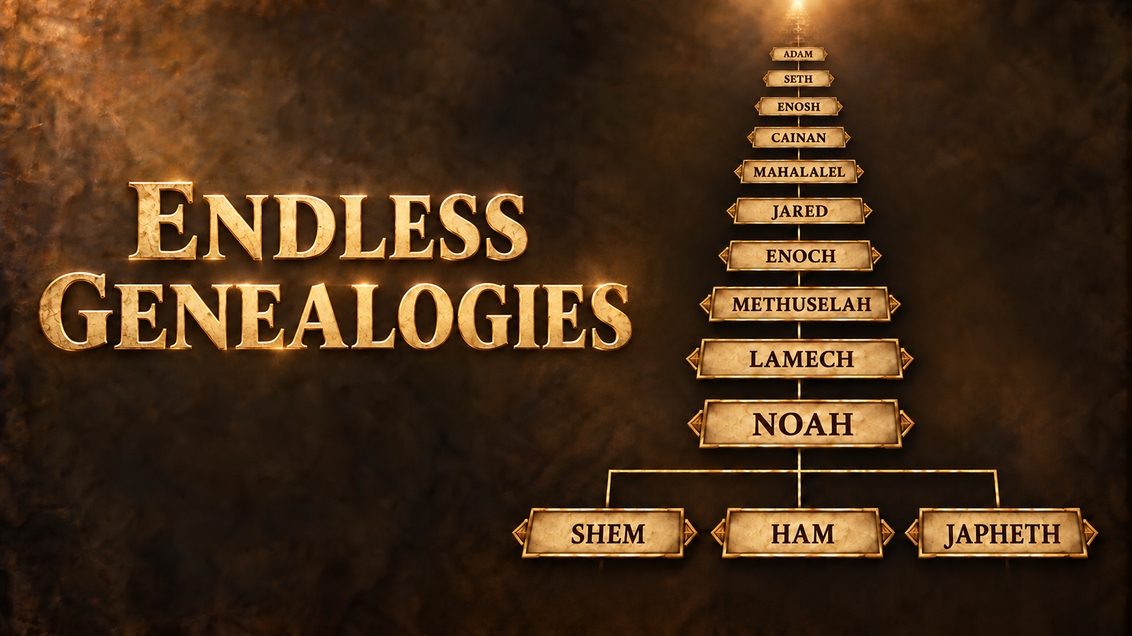

Slide 2
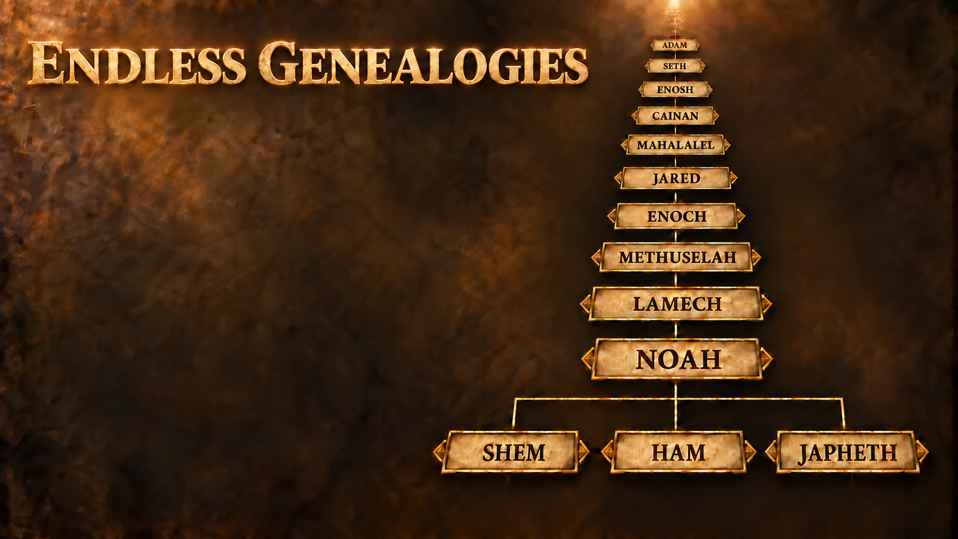
Introduction
1st Timothy 1:3-11
Titus 3:9-11

Slide 3
Gauging Earth’s Age
Genesis 5:1-32
Genesis 7:6
Genesis 11:10-26
Acts 7:2-4
Galatians 3:17
1st Kings 6:1

Slide 4
Gauging Earth’s Age
1st Kings 11:42; 14:21; 15:1-2, 9-10; 22:42; 2nd Kings 8:17, 26; 11:3-4; 12:1; 14:2; 15:1-2, 32-33; 16:1-2; 18:1-2; 21:1, 19; 22:1; 23:31, 36; 2nd Chronicles 36:5-8
Jeremiah 29:10;
2nd Chronicles 36:22-23

Slide 5
Respecting Elders
Luke 3:38
Leviticus 19:32
Proverbs 16:31

Slide 6
Qualifying for Priesthood
Exodus 29:9
Ezra 2:62
Psalm 110:4
Hebrews 7:1-3
Hebrews 7:11-19

Slide 7
Qualifying for Kingship
Genesis 49:10
2nd Samuel 7:16-17
Matthew 1:6, 17;
Luke 3:31-32
Romans 1:3-4

