Slide 1


Slide 2

THE GOSPEL ACCORDING TO GENEALOGY
Introduction
Named for a Reason
Genesis 3:20
Genesis 4:1
Exodus 2:10
Exodus 2:22
1st Samuel 4:21
Renamed for a Reason
Genesis 32:28
John 1:42
Acts 4:36
Matthew 1:1-17

Slide 3
THE GOSPEL ACCORDING TO GENEALOGY
Adam: Man
    “Jehovah God formed man of the dust of the ground, and breathed into his nostrils the breath of life; and man became a living being.” (Genesis 2:17)

Slide 4
THE GOSPEL ACCORDING TO GENEALOGY
Adam: Man
Seth: Appointed
    “Adam knew his wife again, and she bore a son and named him Seth, ‘For God has appointed another seed for me instead of Abel, whom Cain killed.’” (Genesis 4:25)

Slide 5
THE GOSPEL ACCORDING TO GENEALOGY
Adam: Man
Seth: Appointed
Enosh: Mortality
Cainan: Possessor/Possession
Mahalel: Praise of God
Jared: Descending
Enoch: Dedicated
Methuselah: He Dies and it Is Sent
Lamech: Made Low

Slide 6
THE GOSPEL ACCORDING TO GENEALOGY
Noah: Rest
      “He called his name Noah, saying, ‘This one will comfort us concerning our work and the toil of our hands, because of the ground which Jehovah has cursed.’” (Genesis 5:29)

Slide 7
THE GOSPEL ACCORDING TO GENEALOGY
Noah: Rest
Shem: Renown
Arphaxad: Chaldea’s Stronghold
Noah: Rest
Shelah: To Break
Eber: Beyond
Peleg: Division
      “To Eber were born two sons: the name of one was Peleg, for in his days the earth was divided; and his brother's name was Joktan.’” (Genesis 10:25)

Slide 8
THE GOSPEL ACCORDING TO GENEALOGY
Reu: Friend
Serug: Branch
Nahor: Breathing Hard
Terah: Wanderer
Abraham: Father of a Multitude
      “No longer shall your name be called Abram, but your name shall be Abraham; for I have made you a father of many nations.” (Genesis 17:5)

Slide 9
THE GOSPEL ACCORDING TO GENEALOGY
Isaac: Laughing
      “Abraham was one hundred years old when his son Isaac was born to him. And Sarah said, ‘God has made me laugh, and all who hear will laugh with me.’” (Genesis 21:5-6)

Slide 10
THE GOSPEL ACCORDING TO GENEALOGY
Isaac: Laughing
Jacob: Supplanter
      “Afterward his brother came out, and his hand took hold of Esau's heel; so his name was called Jacob.” (Genesis 25:26)

Slide 11
THE GOSPEL ACCORDING TO GENEALOGY
Isaac: Laughing
Jacob: Supplanter
Judah: Praise
      “She conceived again and bore a son, and said, ‘Now I will praise Jehovah.’ Therefore she called his name Judah.” (Genesis 29:35)

Slide 12
THE GOSPEL ACCORDING TO GENEALOGY
Perez: Breach
      “Now it came to pass, at the time for giving birth, that behold, twins were in her womb. And so it was, when she was giving birth, that the one put out his hand; and the midwife took a scarlet thread and bound it on his hand, saying, ‘This one came out first.’ Then it happened, as he drew back his hand, that his brother came out unexpectedly; and she said, ‘How did you break through? This breach be upon you!’ Therefore his name was called Perez. Afterward his brother came out who had the scarlet thread on his hand. And his name was called Zerah.” (Genesis 38:27-30)

Slide 13
THE GOSPEL ACCORDING TO GENEALOGY
Perez: Breach
Hezron: Enclosure
Ram: High
Amminadab: Family of the Prince
Nahshon: Serpent
Salmon: Garment
Boaz: Eager
Obed: Servant
Jesse: Gift
David: Beloved

Slide 14
THE GOSPEL ACCORDING TO GENEALOGY
Solomon: Peaceful
      “Behold, a son shall be born to you, who shall be a man of rest; and I will give him rest from all his enemies all around. His name shall be Solomon, for I will give peace and quietness to Israel in his days.” (1st Chronicles 22:9)

Slide 15
THE GOSPEL ACCORDING TO GENEALOGY
Solomon: Peaceful
Rehoboam: Who Enlarges the People
Abijah: My Father Is Jehovah
Asa: Healer
Jehoshaphat: Jehovah has Judged
Jehoram: Jehovah has Exalted
Uzziah: Jehovah Is My Strength
Jotham: Jehovah Is Perfect
Ahaz: He Holds
Hezekiah: Whom Jehovah Has Strengthened

Slide 16
THE GOSPEL ACCORDING TO GENEALOGY
Manasseh: Causing to Forget
“Joseph called the name of the firstborn Manasseh: ‘For God has made me forget all my toil and all my father's house.’” (Genesis 41:51)

Slide 17
THE GOSPEL ACCORDING TO GENEALOGY
Manasseh: Causing to Forget
Amon: Builder
Josiah: Jehovah Supports
Jeconiah: Jehovah Established
Shealtiel: I Have Asked God
Zerubbabel: Children in Babylon
Abiud: Father of Praise
Eliakim: God Raises
Azor: Helper
Zadok: Righteous

Slide 18
THE GOSPEL ACCORDING TO GENEALOGY
Achim: Establishing
Eliud: God Is My Praise
Eleazar: God Is My Helper
Matthan: Gift
Jacob
Joseph: Increase
    “So she called his name Joseph, and said, ‘Jehovah shall add to me another son.’” (Genesis 30:24)

Slide 19
THE GOSPEL ACCORDING TO GENEALOGY
Jesus: Jehovah Saves
    “She will bring forth a Son, and you shall call His name Jesus, for He will save His people from their sins.’” (Matthew 1:21)

Slide 20
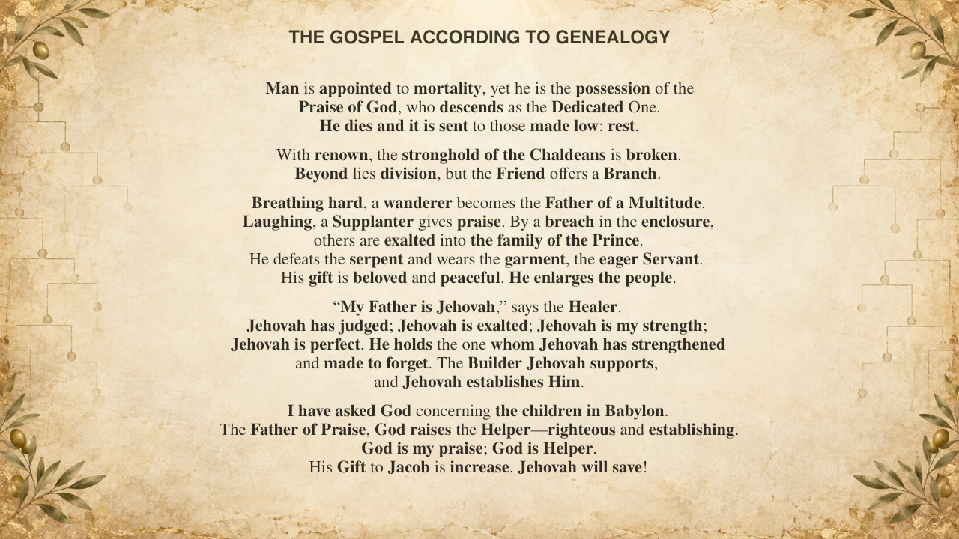
THE GOSPEL ACCORDING TO GENEALOGY
Man is appointed to mortality, yet he is the possession of the
Praise of God, who descends as the Dedicated One.
He dies and it is sent to those made low: rest.
With renown, the stronghold of the Chaldeans is broken.
Beyond lies division, but the Friend offers a Branch.
Breathing hard, a wanderer becomes the Father of a Multitude.
Laughing, a Supplanter gives praise. By a breach in the enclosure,
others are exalted into the family of the Prince.
He defeats the serpent and wears the garment, the eager Servant.
His gift is beloved and peaceful. He enlarges the people.
“My Father is Jehovah,” says the Healer.
Jehovah has judged; Jehovah is exalted; Jehovah is my strength;
Jehovah is perfect. He holds the one whom Jehovah has strengthened
and made to forget. The Builder Jehovah supports,
and Jehovah establishes Him.
I have asked God concerning the children in Babylon.
The Father of Praise, God raises the Helper—righteous and establishing.
God is my praise; God is Helper.
His Gift to Jacob is increase. Jehovah will save!
Notes:
Base slide. Advance to reveal each ancestor from Adam through Jesus.

Slide 21
ADAM
Notes:
Reveal 1 of 60: ADAM

Slide 22
SETH
Notes:
Reveal 2 of 60: SETH

Slide 23
ENOSH
Notes:
Reveal 3 of 60: ENOSH

Slide 24
CAINAN
Notes:
Reveal 4 of 60: CAINAN

Slide 25
MAHALALEL
Notes:
Reveal 5 of 60: MAHALALEL

Slide 26
JARED
Notes:
Reveal 6 of 60: JARED

Slide 27
ENOCH
Notes:
Reveal 7 of 60: ENOCH

Slide 28
METHUSELAH
Notes:
Reveal 8 of 60: METHUSELAH

Slide 29
LAMECH
Notes:
Reveal 9 of 60: LAMECH

Slide 30
NOAH
Notes:
Reveal 10 of 60: NOAH

Slide 31
SHEM
Notes:
Reveal 11 of 60: SHEM

Slide 32
ARPHAXAD
Notes:
Reveal 12 of 60: ARPHAXAD

Slide 33
SHELAH
Notes:
Reveal 13 of 60: SHELAH

Slide 34
EBER
Notes:
Reveal 14 of 60: EBER

Slide 35
PELEG
Notes:
Reveal 15 of 60: PELEG

Slide 36
REU
Notes:
Reveal 16 of 60: REU

Slide 37
SERUG
Notes:
Reveal 17 of 60: SERUG

Slide 38
NAHOR
Notes:
Reveal 18 of 60: NAHOR

Slide 39
TERAH
Notes:
Reveal 19 of 60: TERAH

Slide 40
ABRAHAM
Notes:
Reveal 20 of 60: ABRAHAM

Slide 41
ISAAC
Notes:
Reveal 21 of 60: ISAAC

Slide 42
JACOB
Notes:
Reveal 22 of 60: JACOB

Slide 43
JUDAH
Notes:
Reveal 23 of 60: JUDAH

Slide 44
PEREZ
Notes:
Reveal 24 of 60: PEREZ

Slide 45
HEZRON
Notes:
Reveal 25 of 60: HEZRON

Slide 46
RAM
Notes:
Reveal 26 of 60: RAM

Slide 47
AMMINADAB
Notes:
Reveal 27 of 60: AMMINADAB

Slide 48
NAHSHON
Notes:
Reveal 28 of 60: NAHSHON

Slide 49
SALMON
Notes:
Reveal 29 of 60: SALMON

Slide 50
BOAZ
Notes:
Reveal 30 of 60: BOAZ

Slide 51
OBED
Notes:
Reveal 31 of 60: OBED

Slide 52
JESSE
Notes:
Reveal 32 of 60: JESSE

Slide 53
DAVID
Notes:
Reveal 33 of 60: DAVID

Slide 54
SOLOMON
Notes:
Reveal 34 of 60: SOLOMON

Slide 55
REHOBOAM
Notes:
Reveal 35 of 60: REHOBOAM

Slide 56
ABIJAH
Notes:
Reveal 36 of 60: ABIJAH

Slide 57
ASA
Notes:
Reveal 37 of 60: ASA

Slide 58
JEHOSHAPHAT
Notes:
Reveal 38 of 60: JEHOSHAPHAT

Slide 59
JORAM
Notes:
Reveal 39 of 60: JORAM

Slide 60
UZZIAH
Notes:
Reveal 40 of 60: UZZIAH

Slide 61
JOTHAM
Notes:
Reveal 41 of 60: JOTHAM

Slide 62
AHAZ
Notes:
Reveal 42 of 60: AHAZ

Slide 63
HEZEKIAH
Notes:
Reveal 43 of 60: HEZEKIAH

Slide 64
MANASSEH
Notes:
Reveal 44 of 60: MANASSEH

Slide 65
AMON
Notes:
Reveal 45 of 60: AMON

Slide 66
JOSIAH
Notes:
Reveal 46 of 60: JOSIAH

Slide 67
JECONIAH
Notes:
Reveal 47 of 60: JECONIAH

Slide 68
SHEALTIEL
Notes:
Reveal 48 of 60: SHEALTIEL

Slide 69
ZERUBBABEL
Notes:
Reveal 49 of 60: ZERUBBABEL

Slide 70
ABIUD
Notes:
Reveal 50 of 60: ABIUD

Slide 71
ELIAKIM
Notes:
Reveal 51 of 60: ELIAKIM

Slide 72
AZOR
Notes:
Reveal 52 of 60: AZOR

Slide 73
ZADOK
Notes:
Reveal 53 of 60: ZADOK

Slide 74
ACHIM
Notes:
Reveal 54 of 60: ACHIM

Slide 75
ELIUD
Notes:
Reveal 55 of 60: ELIUD

Slide 76
ELEAZAR
Notes:
Reveal 56 of 60: ELEAZAR

Slide 77
MATTHAN
Notes:
Reveal 57 of 60: MATTHAN

Slide 78
JACOB
Notes:
Reveal 58 of 60: JACOB

Slide 79
JOSEPH
Notes:
Reveal 59 of 60: JOSEPH

Slide 80
JESUS
Notes:
Reveal 60 of 60: JESUS

Slide 81
THE GOSPEL ACCORDING TO GENEALOGY
Conclusion
Hebrews 9:27
Ephesians 1:13-14
Ephesians 4:9-10
John 17:3
Matthew 11:28
Ephesians 2:14
Hebrews 8:12
1st Corinthians 3:11-13
Revelation 17:5-6
Acts 5:31-32

