Slide 1
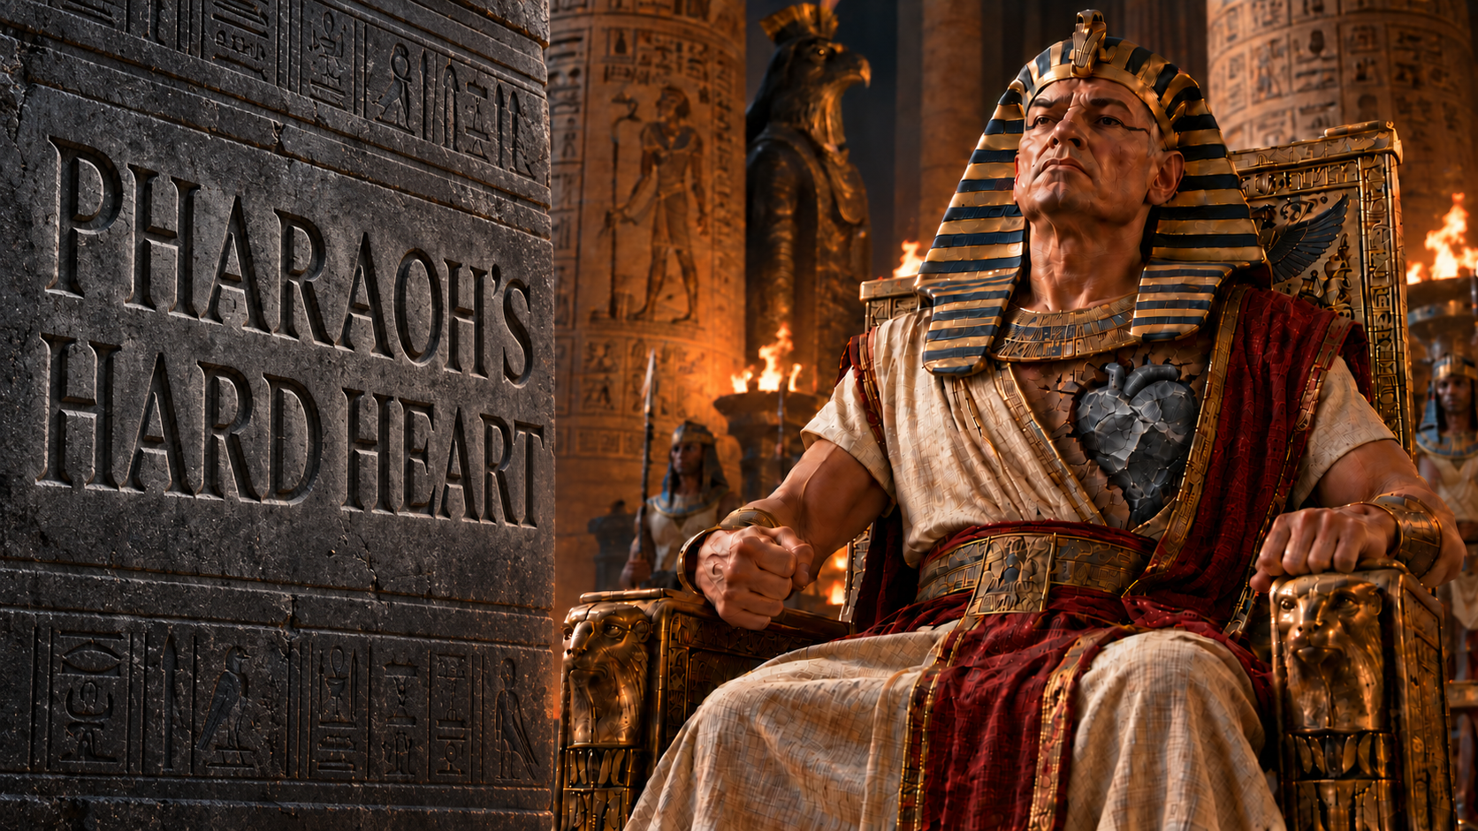

Slide 2
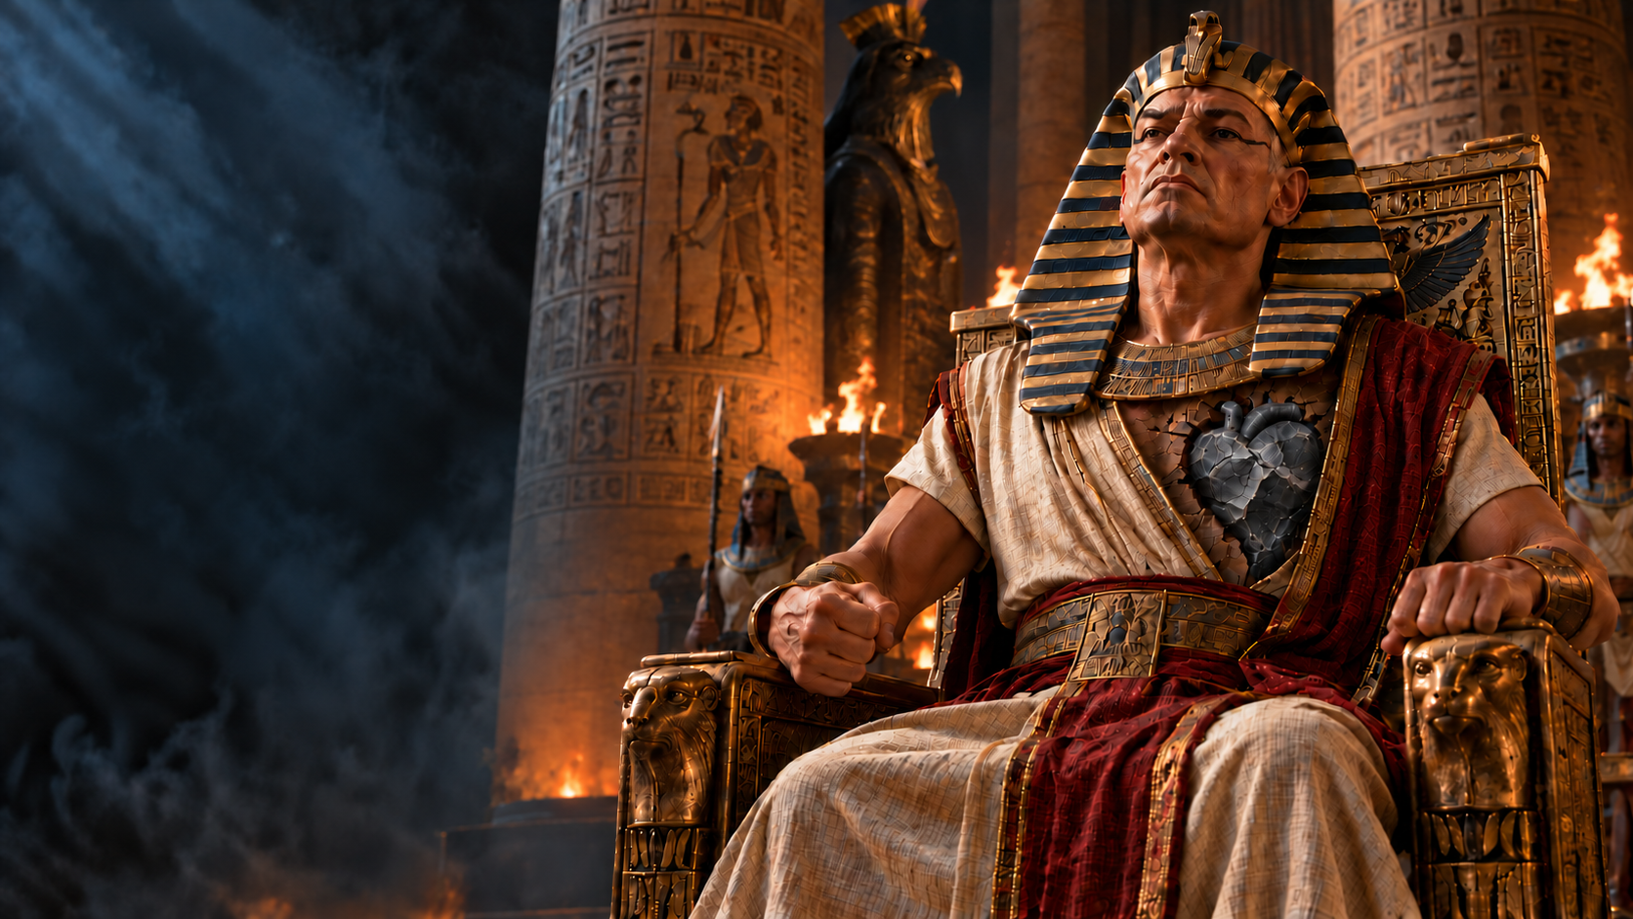
God Hardened Pharaoh’s Heart
Exodus 4:21; 9:12;
10:20, 27; 14:8
Exodus 7:2-5;
10:1-2; 11:9-10; 14:4
Romans 9:14-17
2nd Corinthians 2:16

Slide 3
The Magicians Hardened Pharaoh’s Heart
Exodus 7:11-13, 22-23
Exodus 8:18-19
2nd Timothy 3:8
Deuteronomy 13:1-5
2nd Thessalonians 2:9-12

Slide 4
Pharaoh Hardened His Own Heart
Exodus 8:13, 15, 31-32; 9:34
Exodus 5:2
Hebrews 3:14-19
Proverbs 28:14
Zechariah 7:12
Proverbs 4:23
James 1:14-15

Slide 5
Conclusion
Acts 19:9
Acts 2:36-38

