Slide 1
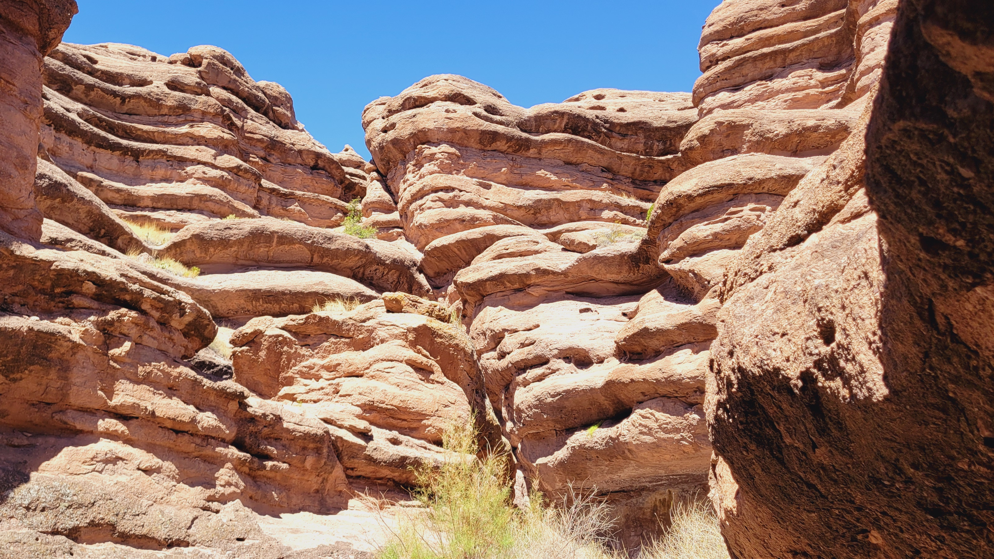
JOEL

Slide 2
# 1
JOEL 1
Who wrote this prophecy?

Slide 3
# 2
JOEL 1
To whom is this prophecy addressed?

Slide 4
# 3
JOEL 1
When was this book written?

Slide 5
# 4
JOEL 1
Why were Joel’s readers to ponder the past and what were they to do in the future?

Slide 6
# 5
JOEL 1
Identify the four devourers.

Slide 7
# 6
JOEL 1
What had befallen the drunkards, the priests, the vinedressers, and the farmers?

Slide 8
# 7
JOEL 1
Was this a literal plague of locusts?

Slide 9
# 8
JOEL 1
Whose land, whose vine, and whose fig tree were being ruined?

Slide 10
# 9
JOEL 1
What were the priests called to do in their wailing and lamentations?

Slide 11
# 10
JOEL 1
What was “at hand” that they were to cry about?

Slide 12
# 11
JOEL 1
Which of the curses that Jehovah warned Israel about before entering the Promised Land (Deuteronomy 28:15-68) are upon them in the primary text?

