Slide 1
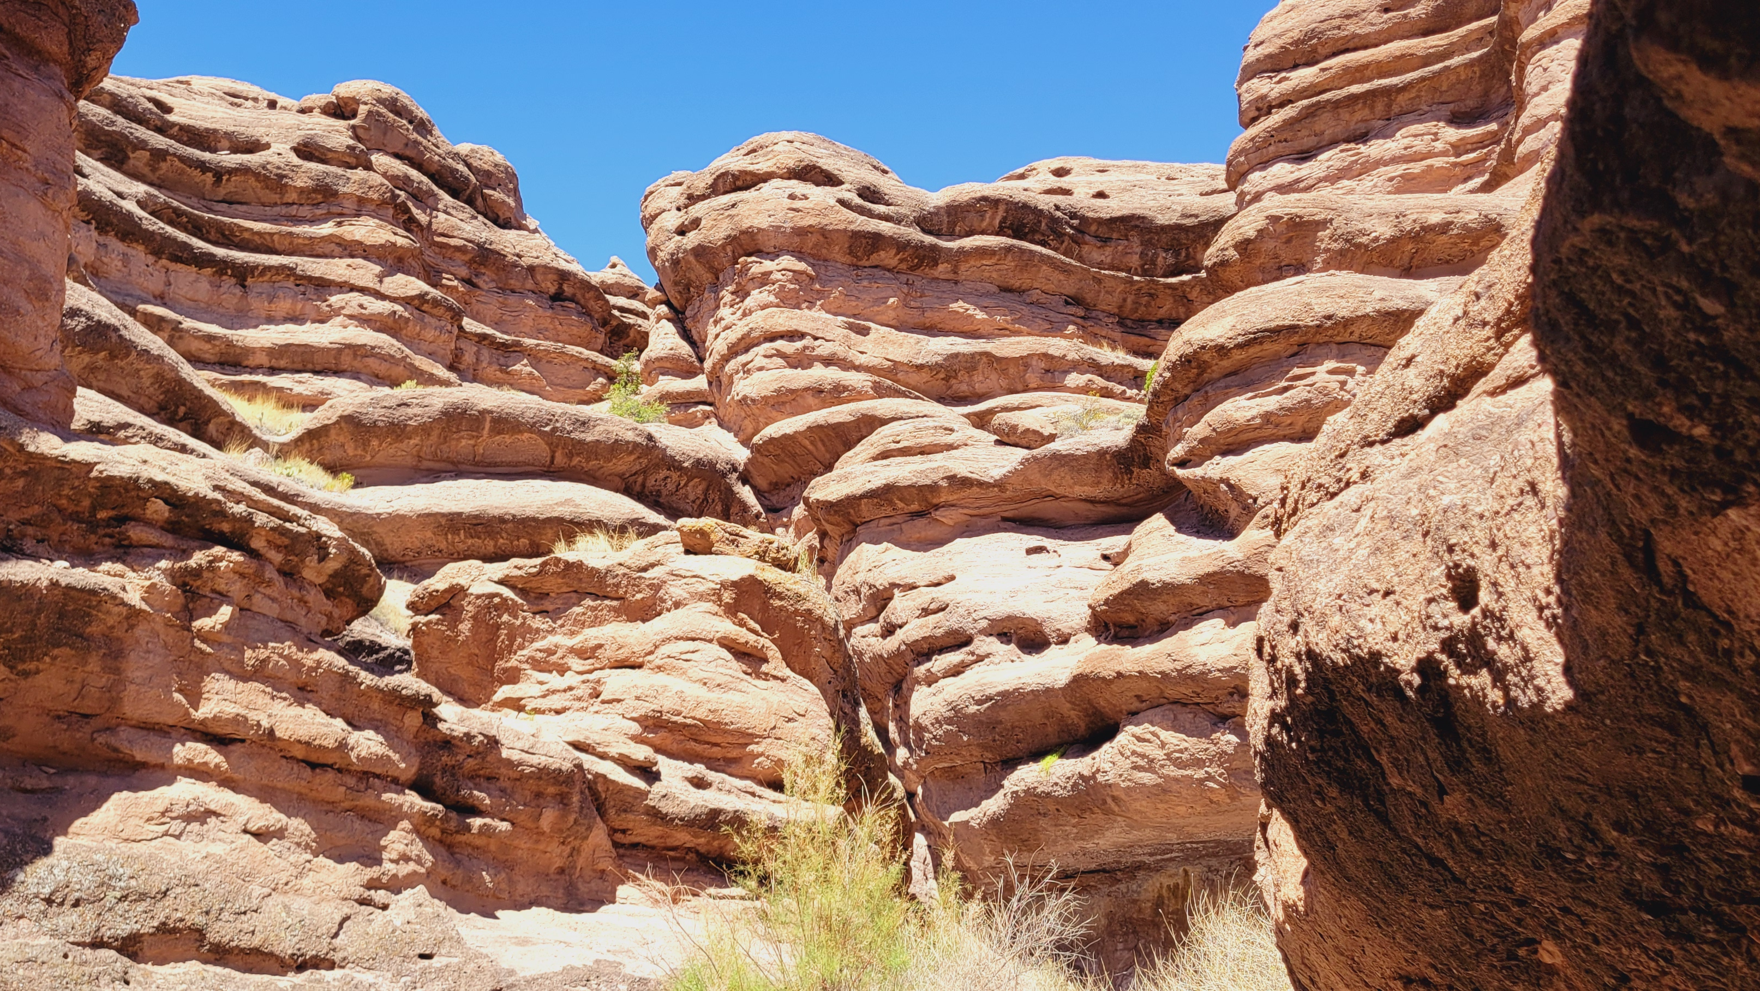
JOEL

Slide 2
# 1
JOEL 2
What is the first blast of the horn intended to communicate?

Slide 3
# 2
JOEL 2
How would this day of Jehovah look? How would it sound? How would it feel?

Slide 4
# 3
JOEL 2
Describe the land before and behind the locust invasion, respectively.

Slide 5
# 4
JOEL 2
How extensive was this infestation?

Slide 6
# 5
JOEL 2
How could they get Jehovah to “relent” from this calamity?

Slide 7
# 6
JOEL 2
What did God expect them to “rend?”

Slide 8
# 7
JOEL 2
What qualities of God move Him to “relent?”

Slide 9
# 8
JOEL 2
After the locust curse, what might God do in His relenting?

Slide 10
# 9
JOEL 2
What is the second blast of the horn intended to communicate?

Slide 11
# 10
JOEL 2
What was expected of the priests?

Slide 12
# 11
JOEL 2
How would Jehovah’s response to the people’s repentance be characterized?

Slide 13
# 12
JOEL 2
What action would Jehovah take because of Judah’s repentance?

Slide 14
# 13
JOEL 2
What had already “come up” and what would yet “rise?”

Slide 15
# 14
JOEL 2
With their restoration to God, what would Judah come to know?

Slide 16
# 15
JOEL 2
Identify the fulfillment of the prophecy concerning what would “come to pass afterward.”

Slide 17
# 16
JOEL 2
Upon whom would the Lord “pour out [His] Spirit?”

Slide 18
# 17
JOEL 2
What would the outpouring of the Spirit enable?

Slide 19
# 18
JOEL 2
What would precede the “great and awesome day of Jehovah?”

Slide 20
# 19
JOEL 2
How could salvation be obtained?

Slide 21
# 19
JOEL 2
Where would deliverance come from?

