Slide 1
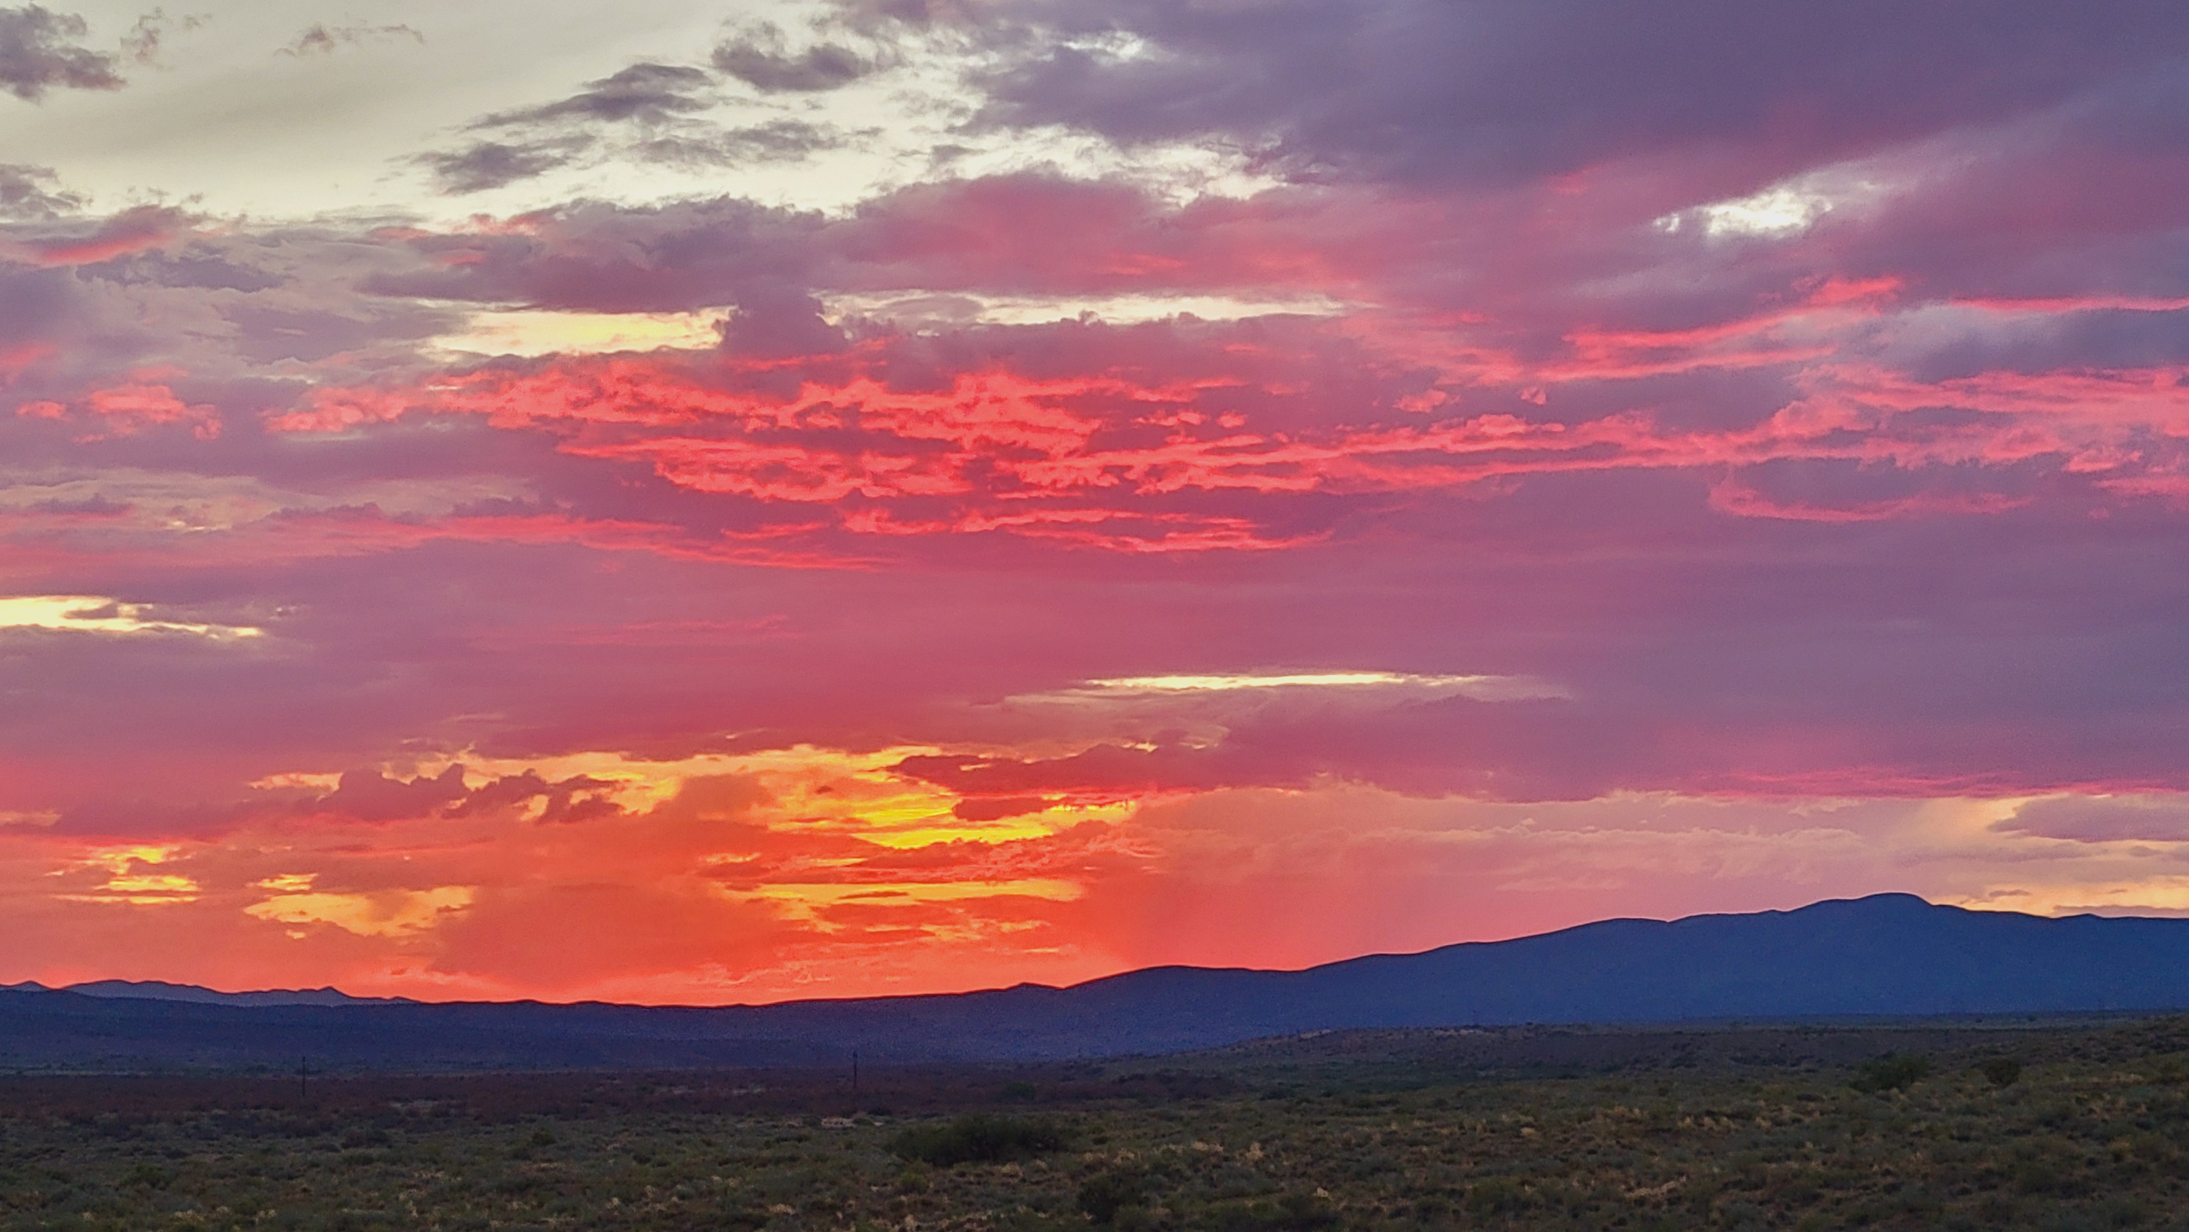
PHILIPPIANS 1

Slide 2
Who sent this epistle?
PHILIPPIANS 1

Slide 3
Who were the recipients?
PHILIPPIANS 1

Slide 4
Describe the establishment of the church in that location.
PHILIPPIANS 1

Slide 5
Explain what bishops and deacons are.
PHILIPPIANS 1

Slide 6
Where was the epistle written from?
PHILIPPIANS 1

Slide 7
How did Paul remember the Philippians?
PHILIPPIANS 1

Slide 8
What did Paul have in mind referring to the Philippians’ “fellowship in the gospel from the first day until now?”
PHILIPPIANS 1

Slide 9
What did Paul pray for concerning the brethren at Philippi?
PHILIPPIANS 1

Slide 10
Name two benefits the apostle observed about his incarceration.
PHILIPPIANS 1

Slide 11
Why was Paul rejoicing?
PHILIPPIANS 1

Slide 12
What did he expect through their prayers and the “supply of the Spirit?”
PHILIPPIANS 1

Slide 13
“Whether by life or by death,” what did Paul intend?
PHILIPPIANS 1

Slide 14
What did he perceive to be the benefits either of life or death?
PHILIPPIANS 1

Slide 15
What goals did he set before them?
PHILIPPIANS 1

Slide 16
What challenges lay before them?
PHILIPPIANS 1

