Slide 1
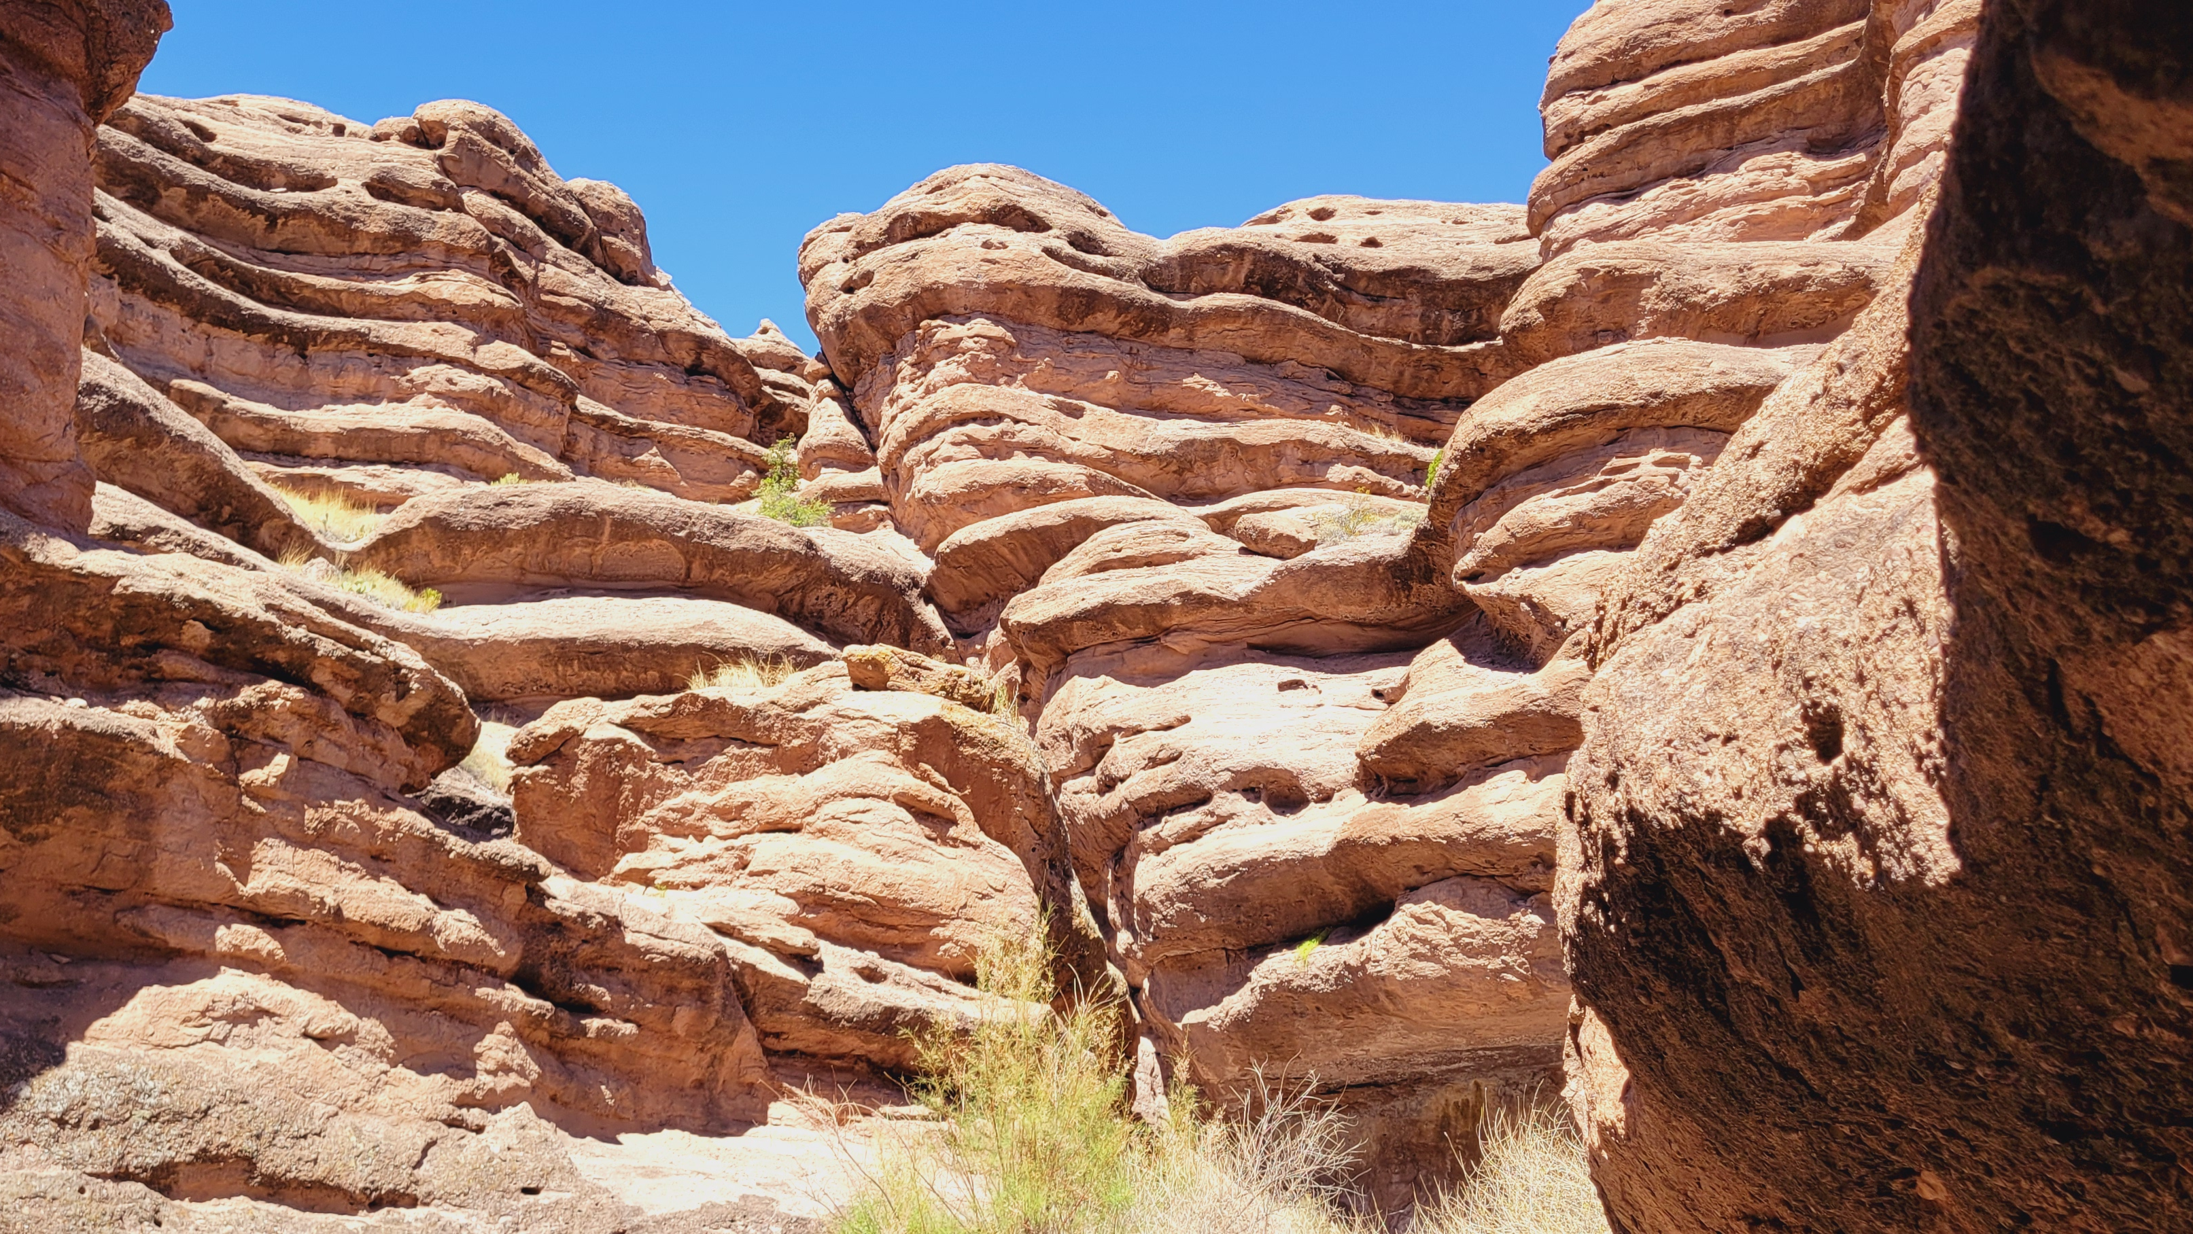
JOEL

Slide 2
# 1
JOEL 3
When will the events foretold occur?

Slide 3
# 2
JOEL 3
Who are the “captives” God intended to “bring back?”

Slide 4
# 3
JOEL 3
Where would Jehovah “gather all nations?”

Slide 5
# 4
JOEL 3
What would He do with “all nations” at Jehoshaphat?

Slide 6
# 5
JOEL 3
What are the charges levelled against the nations?

Slide 7
# 6
JOEL 3
What was God’s first question to Tyre, Sidon, and Philistia?

Slide 8
# 7
JOEL 3
What was His second question to them?

Slide 9
# 8
JOEL 3
What had the Tyrians, Sidonians, and Philistines done to merit retaliation from God?

Slide 10
# 9
JOEL 3
How would God “return” their “retaliation” upon their “own head?”

Slide 11
# 10
JOEL 3
What are the nations summoned to?

Slide 12
# 11
JOEL 3
What were the nations to do with their plowshares and pruning hooks?

Slide 13
# 12
JOEL 3
Did God literally mean for armed conflict or some other adversarial situation?

Slide 14
# 13
JOEL 3
How else does God illustrate His impending judgment?

Slide 15
# 14
JOEL 3
After the analogy, what are the multitudes again warned about directly?

Slide 16
# 15
JOEL 3
Explain the sun, moon, and stars going dark.

Slide 17
# 16
JOEL 3
Where would God’s voice be heard coming from?

Slide 18
# 17
JOEL 3
What effect does His voice have upon “the heavens and earth?”

Slide 19
# 18
JOEL 3
While heaven and earth were shaking, what would become of Israel?

Slide 20
# 19
JOEL 3
What would they come to know?

Slide 21
# 20
JOEL 3
What would become of “Jerusalem?”

Slide 22
# 21
JOEL 3
What is the significance of the wine, milk, and water all dripping, flowing, and flooding?

Slide 23
# 22
JOEL 3
Why would Egypt and Edom be desolated?

Slide 24
# 23
JOEL 3
In what sense would Judah and Jerusalem always abide?

Slide 25
# 24
JOEL 3
What would God who dwells in Zion do about blood?

