Slide 1
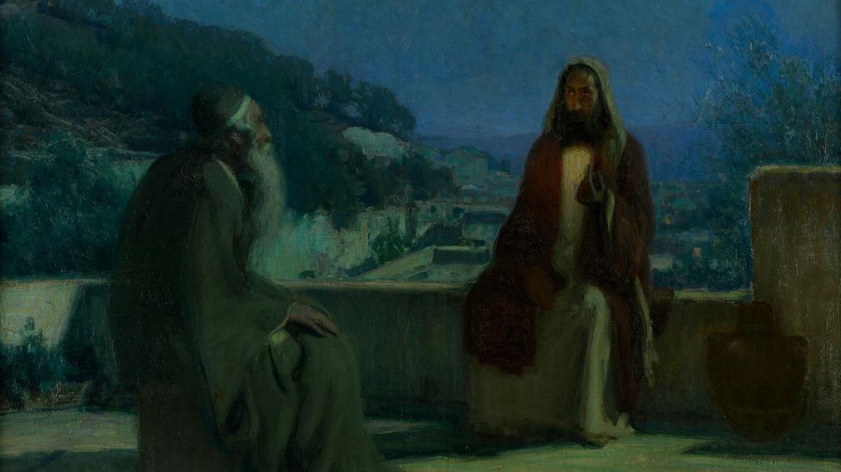
NICODEMUS
MEETING THE MESSIAH

Slide 2
Who Was Nicodemus?
    John 3:1, 10
    Luke 24:18-20; Acts 4:24-28
    John 12:42-43
        Romans 10:9-10
        Matthew 10:32-33
    1st Corinthians 1:26-29

Slide 3
When did Nicodemus visit?
    John 3:2; 7:50; 19:39
    Matthew 21:28-32
    John 7:32, 45-52
    John 19:38-42
    Luke 23:50-51
    Mark 15:43

Slide 4
Why did Nicodemus meet Jesus?
    John 3:2
    Mark 3:22
    John 10:37-38

Slide 5
What did Nicodemus learn?
    John 3:3
        Mark 10:15
    John 3:4-5
        1st Corinthians 6:9-11
        Titus 3:3-7
    John 3:6-7
        Romans 8:5, 9
        1st Peter 3:21
    John 3:8-21
        Ecclesiastes 11:5
        1st Corinthians 2:13-14

