Slide 1
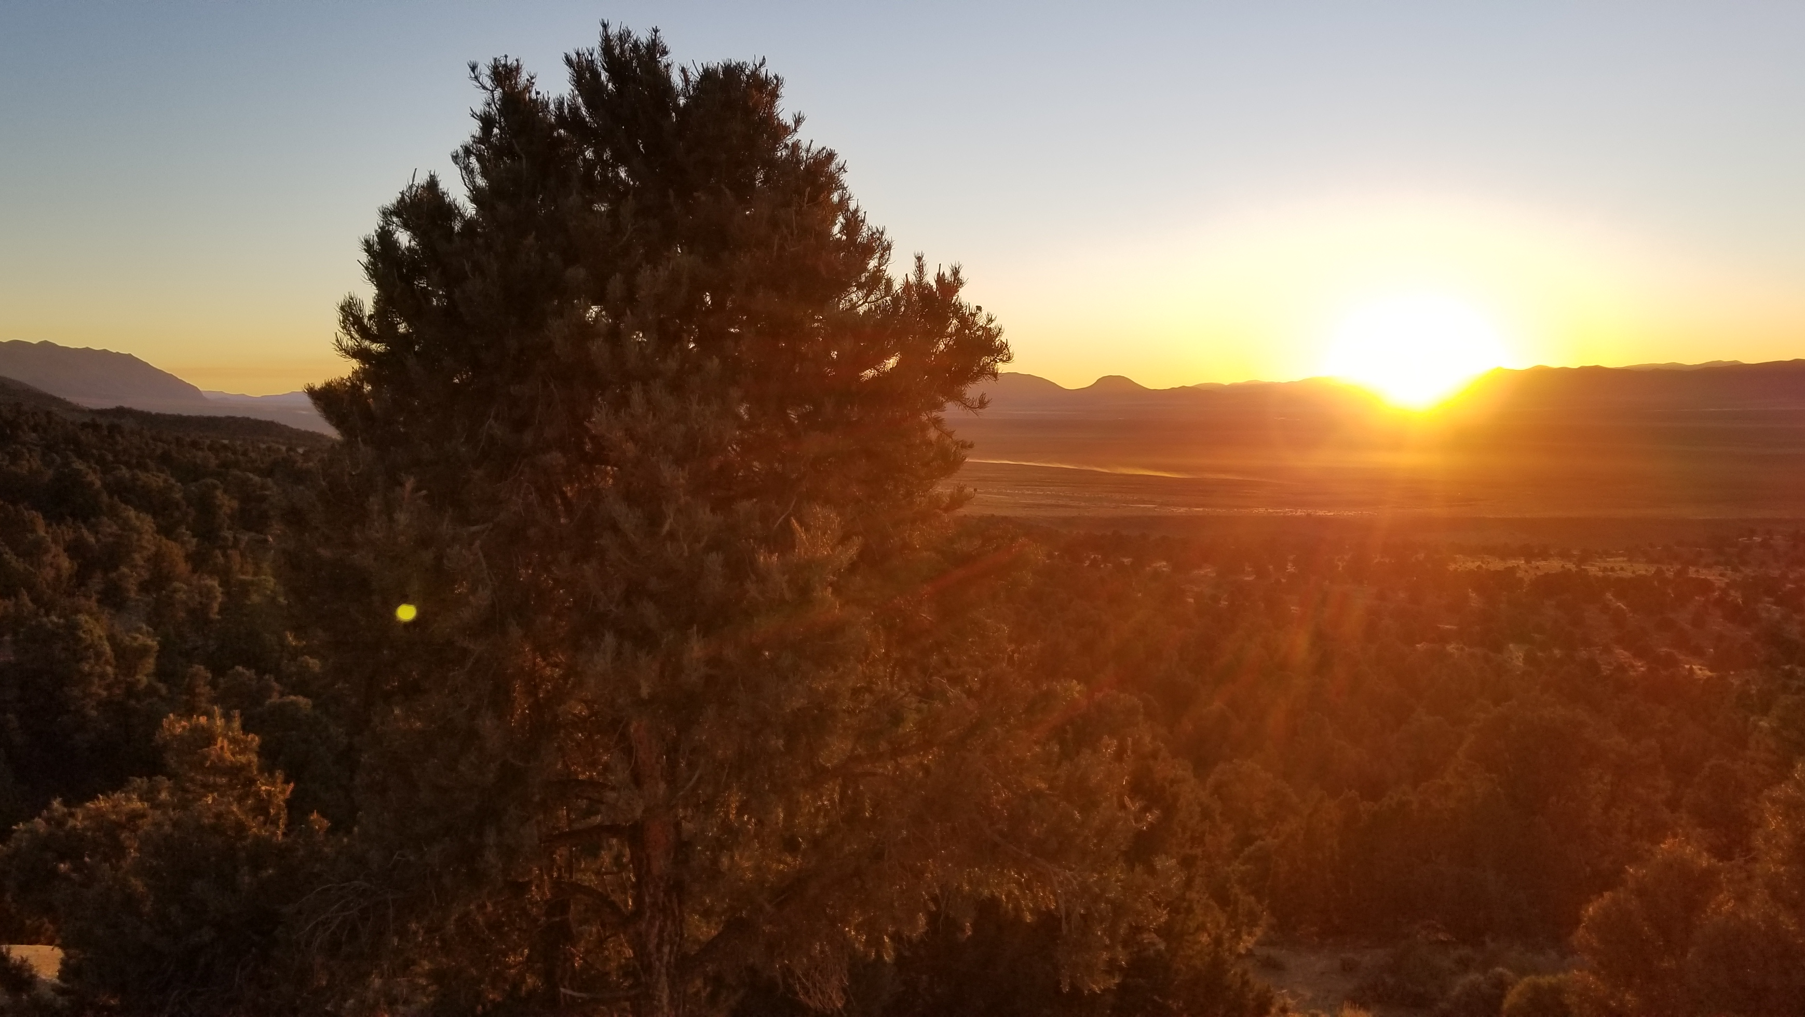
“SAYING THAT THE RESURRECTION IS ALREADY PAST”

Slide 2
“SAYING THAT THE RESURRECTION IS ALREADY PAST”
Introduction
Revelation 1:1, 3
2nd Timothy 2:16, 18

Slide 3
“SAYING THAT THE RESURRECTION IS ALREADY PAST”
If Christ Already Came, the Lord’s Supper Is a Relic of a Bygone Era
1st Corinthians 11:23-26
Acts 20:7
Hebrews 10:24-25

Slide 4
“SAYING THAT THE RESURRECTION IS ALREADY PAST”
If the Resurrection Is Past, Marriage Is Null
Matthew 22:30
Hebrews 13:4; 1st Corinthians 6:18

Slide 5
“SAYING THAT THE RESURRECTION IS ALREADY PAST”
If the Resurrection Is Past, Death Is Impossible
Luke 20:34-36
1st Corinthians 15:35-58

Slide 6
“SAYING THAT THE RESURRECTION IS ALREADY PAST”
If the Resurrection Is Past, Baptism Is Irrelevant
Romans 6:3-5
1st Corinthians 15:29

Slide 7
“SAYING THAT THE RESURRECTION IS ALREADY PAST”
If the Judgment Is Past, the Universe Should Be, Too
John 6:40; 12:48
2nd Peter 3:7-13

Slide 8
“SAYING THAT THE RESURRECTION IS ALREADY PAST”
Conclusion
Ephesians 4:4-6; Romans 8:24
1st Thessalonians 4:13-5:11

