Slide 1
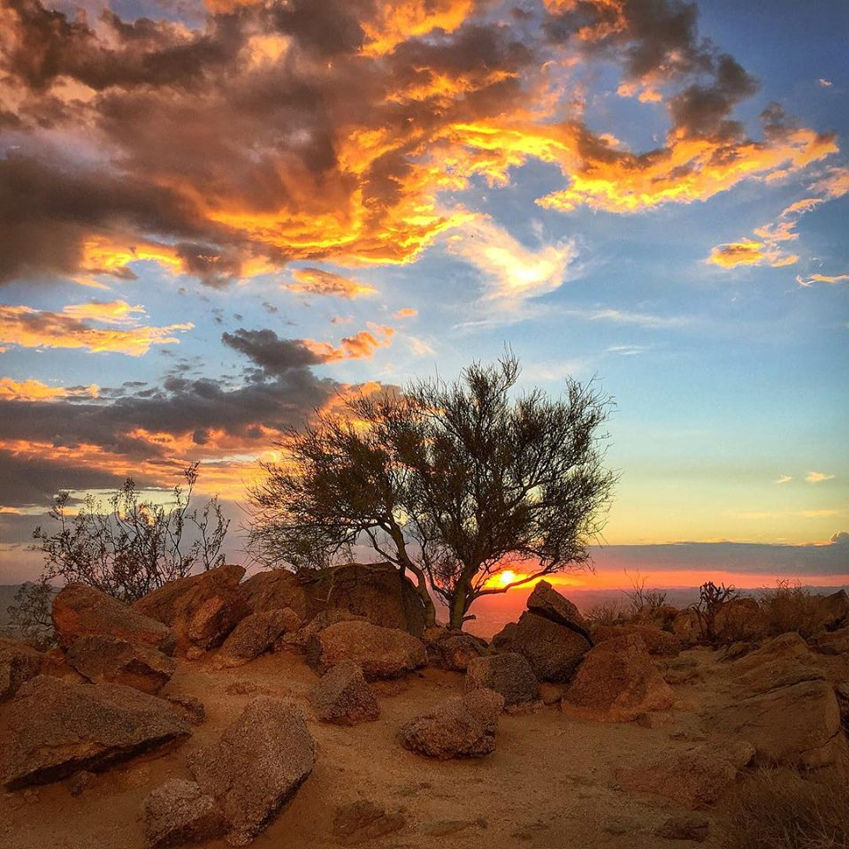
MESSIANIC MILESTONES
the RETURN of the MESSIAH

Slide 2
Why will He return?
2nd Timothy 4:1
Matthew 25:31-46
Jude 14-15
Hebrews 9:27-28

Slide 3
How will He return?
Acts 1:9-11
1st Thessalonians 4:13-16
2nd Thessalonians 1:3-12

Slide 4
When will He return?
1st Thessalonians 5:1-11; 2nd Peter 3:1-10
Acts 17:30-31
1st Thessalonians 4:15-18

Slide 5
Where will He return?
2nd Peter 3:7, 10-13
1st Thessalonians 4:17

Slide 6
Who will be there when He returns?
Matthew 16:27
2nd Corinthians 5:10-11
Matthew 25:31, 41
Acts 10:42

