Slide 1
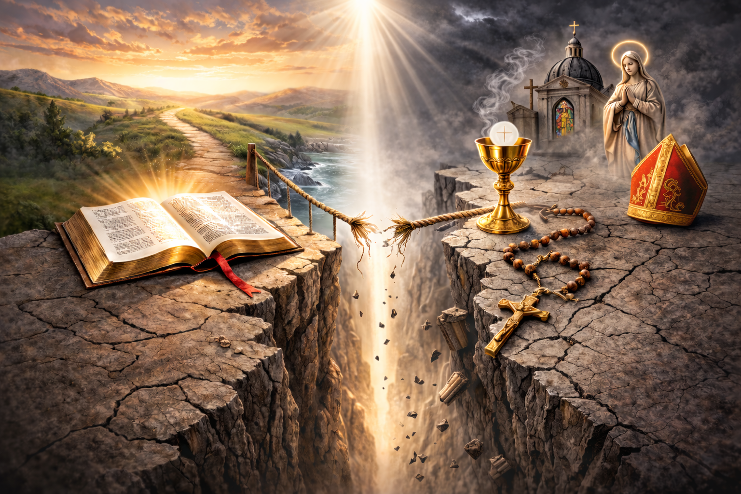
Truth or Tradition?
A Comparison of Scripture and Catholicism

Slide 2
Scripture Not Enough?
“There is nowhere in the New Testament a clear, methodical statement of the teaching of Christ. It was never intended as such.” (Rev. Bertrand Conway, The Question Box, p 66)

Slide 3
Only the Catholic Church Can Interpret?
“The task of giving an authentic interpretation of the Word of God, whether in its written form or in the form of Tradition, has been entrusted to the living teaching office of the Church alone. Its authority in this matter is exercised in the name of Jesus Christ." This means that the task of interpretation has been entrusted to the bishops in communion with the successor of Peter, the Bishop of Rome. (Cath Cat. ¶85)

Slide 4
Tradition = Scripture
“Sacred Tradition and Sacred Scripture, then, are bound closely together, and communicate one with the other. For both of them, flowing out from the same divine well-spring, come together in some fashion to form one thing, and move towards the same goal.” (Cath. Cat.¶80)

Slide 5
Tradition = Scripture
“The church does not derive her certainty about all revealed truth from the Holy Scriptures alone. Both Scripture and tradition must be accepted and honored with equal sentiments of devotion and reverence.” (Cath. Cat. ¶82)

Slide 6
Tradition = Scripture
• The Mass [394 A.D.]
• Veneration of saints and images [375 A.D.]
• Veneration of Mary; "Mother of God" [431 A.D.]
• Extreme Unction (Last rites) [526 A.D.]
• Purgatory [593 A.D.; dogma in 1439 A.D.]
• Worship Of Relics [786 A.D.]
• Holy water [850 A.D.]
• College of Cardinals established [927 A.D.]
• Canonization of "saints" [995 A.D.]

Slide 7
Tradition = Scripture
• Celibacy Of The Priesthood [Decreed 1079, adopted 1139 A.D.]
• The Rosary [1090 A.D.]
• Indulgences [1190 A.D.]
• Transubstantiation [1215 A.D.]
• Church tradition equal to Bible authority [1545 A.D.]
• Prayer To Saints [1594 A.D.]
• Immaculate Conception of Mary [official dogma 1854 A.D]
• Papal Infallibility [1870]
• The Bodily Assumption of Mary [1950 A.D.]

Slide 8
Tradition = Scripture?
What about…
Jude :3
John 16:13
1 Corinthians 13:8-10

Slide 9
Tradition ≠Truth
Jesus rejected man-made religious tradition as authoritative
Mark 7:5-13
Matthew 15:3

Slide 10
Tradition ≠Truth
The messengers were inspired, not “the Church.” God spoke through men, not an organization.
1 Tim 3:15
2 Pet 1:20-21
Eph 3:3-5
Gal 2:11-12
1 Cor 2:10

Slide 11
SCRIPTURE Stands Alone
The inspired word of God is sufficient to save man’s soul and to direct our work.
2 Tim 3:16-17
2 Pet 1:3

Slide 12
Truth or Tradition?
A Comparison of Scripture and Catholicism

