Slide 1
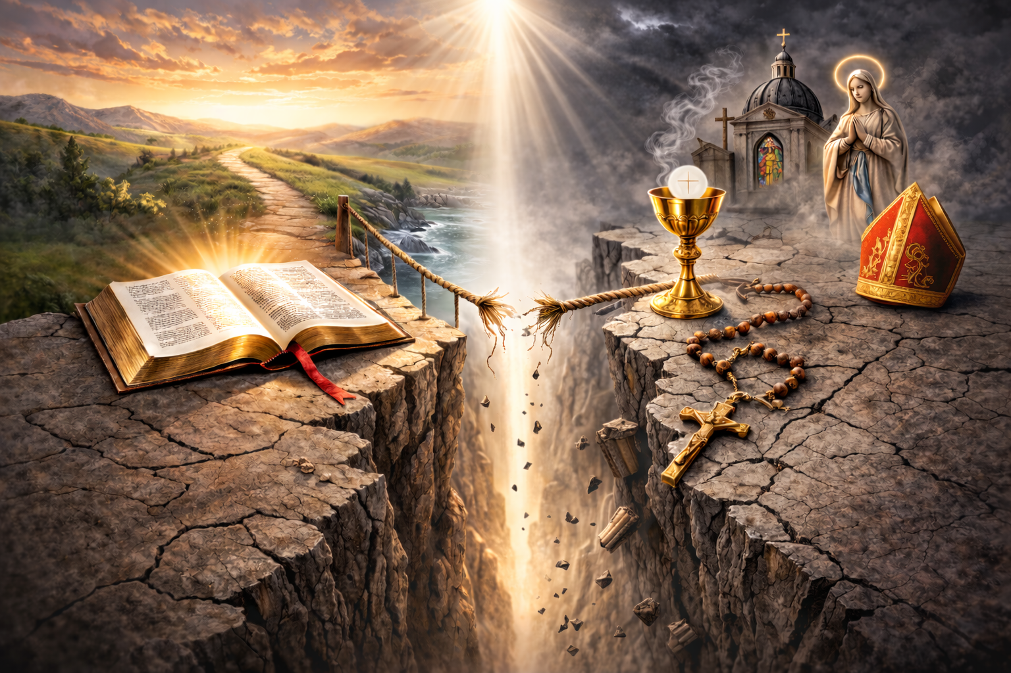
Truth or Tradition?
A Comparison of Scripture and Catholicism

Slide 2
The Truth About
MARY
Magnified or Misunderstood?

Slide 3
Mary’s extra special place
“Among all the women who ever lived, the mother of Jesus Christ is the most celebrated, the most venerated, the most portrayed, the most honored in the naming of girl babies and churches. Even the Koran praises her chastity and faith. Among Roman Catholics, the Madonna is recognized not only as the mother of God, but also , according to modern Popes, as the Queen of the Universe, Queen of Heaven, Seat of Wisdom, and even the Spouse of the Holy Spirit.” (Richard N. Ostling, “Hand-maid of Feminist?” Time, Dec 30, 1991, pg 62)
The Truth About
MARY

Slide 4
Mary’s extra special place
"At the command of Mary all obey, even God. She is omnipotent, for the queen, according to all laws, enjoys the same privileges as the king; and since the son's power also belong to the mother, this Mother is made omnipotent by an omnipotent Son." (Alphonsus Ligouri, 1750, The Glories of Mary, p 114)
The Truth About
MARY

Slide 5
Mary’s Immaculate Conception
“The most Blessed Virgin Mary was, from the first moment of her conception, by a singular grace and privilege of almighty God and by virtue of the merits of Jesus Christ, Saviour of the human race, preserved immune from all stain of original sin.” (Cath. Cat., 491)
The Truth About
MARY

Slide 6
Mary’s Immaculate Conception
A reaction to “original sin,” but…
ALL are born without sin: Matt 18:3-5
Mary herself confessed God was her Savior: Luke 1:47
The Truth About
MARY

Slide 7
Mary’s Perpetual Virginity
"The deepening of faith in the virginal motherhood led the Church to confess Mary's real and perpetual virginity even in the act of giving birth to the Son of God made man. In fact, Christ's birth "did not diminish his mother's virginal integrity but sanctified it ... and so the liturgy of the Church celebrates Mary as Aeiparthenos, the ‘Ever-virgin.’" (C. C., 499)
"Jesus is Mary's only son" (C. C., 501)
The Truth About
MARY

Slide 8
Mary’s Perpetual Virginity
BUT the Bible implies she had other children
Matt 1:25
Luke 2:7
The Bible states Jesus had siblings
Matt 12:46, 13:55-56
John 2:12, 7:3-5
Gal 1:19
The Truth About
MARY

Slide 9
Mary’s Assumption Into Heaven
"Finally the Immaculate Virgin, preserved free from all stain of original sin, when the course of her earthly life was finished, was taken up body and soul into heavenly glory, and exalted by the Lord as Queen over all things, so that she might be the more fully conformed to her Son, the Lord of lords and conqueror of sin and death." ... “The Assumption of the Blessed Virgin is a singular participation in her Son's Resurrection and an anticipation of the resurrection of other Christians." (C. C., 966)
The Truth About
MARY

Slide 10
Mary’s Assumption Into Heaven
"The Most Blessed Virgin Mary, when the course of her earthly life was completed, was taken up body and soul into the glory of heaven, where she already shares in the glory of her Son's Resurrection, anticipating the resurrection of all members of his Body." (C.C., 974)
The Truth About
MARY

Slide 11
Mary’s Assumption Into Heaven
"Fundamentalists ask, 'Where is the proof from Scripture?' Strictly, there is none. ... The mere fact that the Church teaches the doctrine of the Assumption as something definitely true is a guarantee that it is true." (Catholicism and Fundamentalism, Karl Keating, p 275)
The Truth About
MARY

Slide 12
Mary, Mediatrix / “Co-Redemptrix”
“Mary’s role in the church is inseparable from her union with Christ and flows directly from it. This union of the mother and the Son in the work of salvation is made manifest from the time of Christ’s virginal conception to His death.” (C.C., 964)
The Truth About
MARY

Slide 13
Mary, Mediatrix / “Co-Redemptrix”
“Being obedient she (Mary) became the cause of salvation for herself and for the whole human race” (C.C., 494)
“Therefore the Blessed Virgin is invoked in the Church under the titles of Advocate, Helper, Benefactress, and Mediatrix” (C.C., 969)
The Truth About
MARY

Slide 14
Mary, Mediatrix / “Co-Redemptrix”
Jesus, not Mary, is our Savior
—John 4:41-42
Jesus, not Mary, is or Redeemer
—Eph 1:7
Jesus, not Mary, is our Mediator
—1 Tim 2:5
Jesus, not Mary, is Intercessor
—Heb 7:25
The Truth About
MARY

Slide 15
Mary, Mediatrix / “Co-Redemptrix”
2025 “Revision”
In Mater Populi Fidelis (“The Mother of the Faithful People of God”), the Dicastery for the Doctrine of the Faith (DDF) said when an expression requires frequent explanation to maintain the correct meaning, it becomes unhelpful. (thecatholictelegraph.com/vatican-nixes-use-of-co-redemptrix-mediatrix-as-titles-for-mary/102874)
The Truth About
MARY

Slide 16
Mary, Mediatrix / “Co-Redemptrix”
2025 “Revision”
In this case, the expression ‘co-redemptrix’ does not help extol Mary as the first and foremost collaborator in the work of redemption and grace, for it carries the risk of eclipsing the exclusive role of Jesus Christ,” according to the doctrinal note, released Nov. 4, 2025." (vatican.va/roman_curia/congregations/cfaith/documents/rc_ddf_doc_20251104_mater-populi-fidelis_en.html)
The Truth About
MARY

Slide 17
Mary, Mediatrix / “Co-Redemptrix”
2025 “Revision”
The title “Co-redemptrix” first appeared in the fifteenth century as a correction to the invocation “Redemptrix” (as an abbreviated form of the title, “Mother of the Redeemer”), which had been attributed to Mary since the tenth century. (vatican.va/roman_curia/congregations/cfaith/documents/rc_ddf_doc_20251104_mater-populi-fidelis_en.html)
The Truth About
MARY

Slide 18
Mary, Mediatrix / “Co-Redemptrix”
2025 “Revision”
The Second Vatican Council’s terminology regarding mediation primarily refers to Christ; it sometimes also refers to Mary, but in a clearly subordinate manner. In fact, the Council preferred to use a different terminology for her: one centered on cooperation or maternal assistance. (vatican.va/roman_curia/congregations/cfaith/documents/rc_ddf_doc_20251104_mater-populi-fidelis_en.html)
The Truth About
MARY

Slide 19
Mary, Mediatrix / “Co-Redemptrix”
2025 “Revision”
Mary’s participation in Christ’s work becomes evident when one begins from the conviction that the risen Lord promotes, transforms, and enables believers to collaborate with him in his work. (vatican.va/roman_curia/congregations/cfaith/documents/rc_ddf_doc_20251104_mater-populi-fidelis_en.html)
The Truth About
MARY

Slide 20
The Truth About
MARY
Magnified or Misunderstood?

