Slide 1
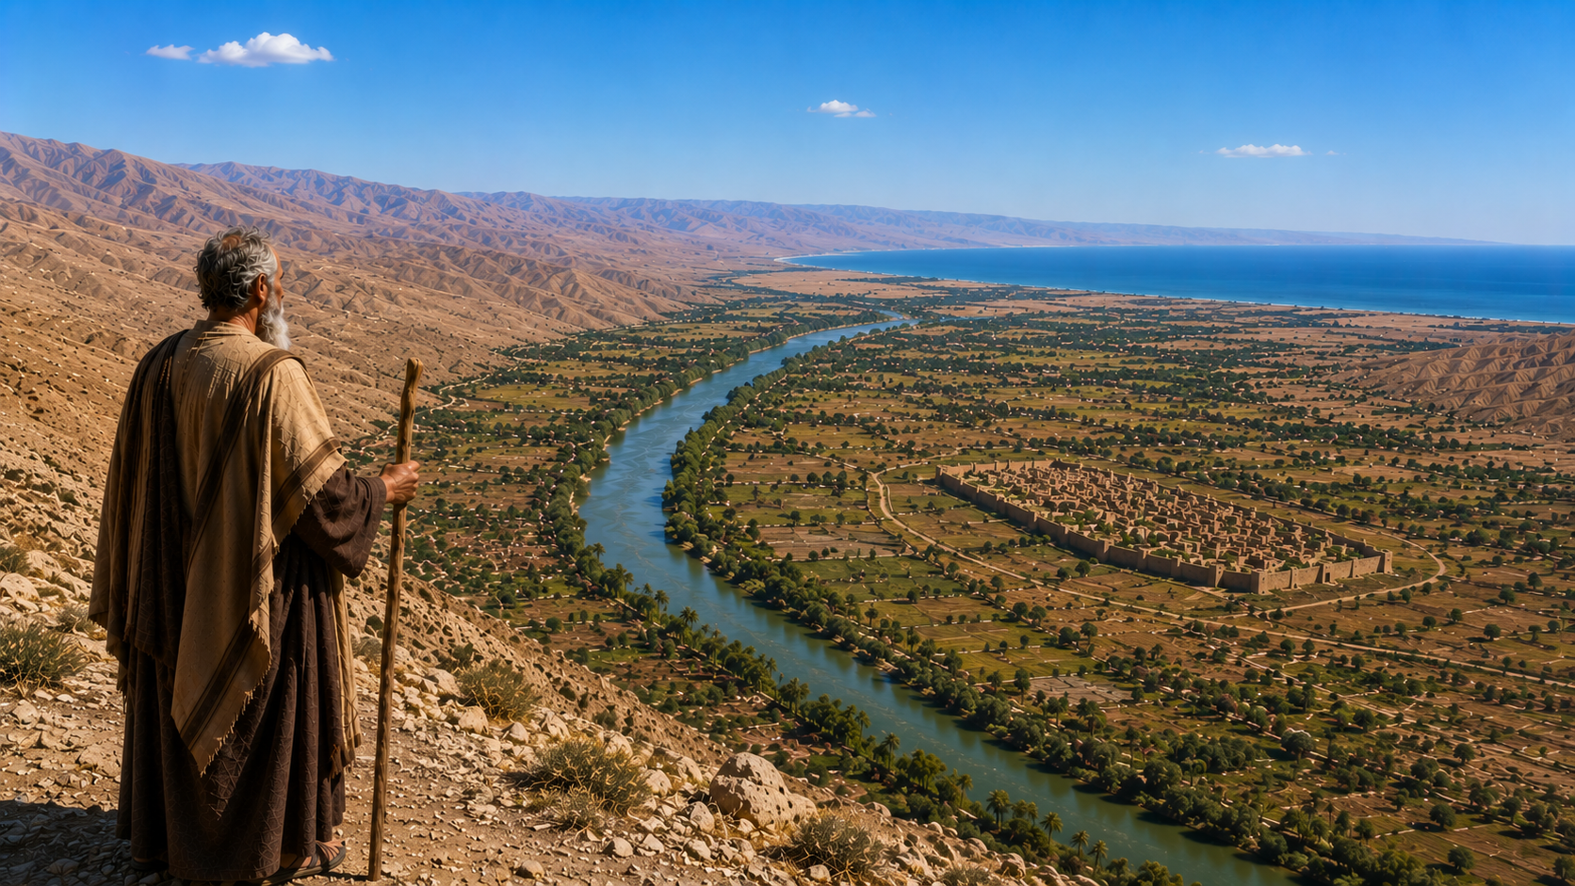
PSALM 90

Slide 2
PSALM 90
“Lord, You have been our dwelling place”
    Acts 7:20-23
    Acts 7:23-30
    Numbers 14:29-34

Slide 3
PSALM 90
“In all generations”
    Genesis 12:1
    Genesis 15:13
    Hebrews 11:38-40

Slide 4
PSALM 90
“From everlasting to everlasting, You are God”
    Daniel 7:19
    Isaiah 46:9-10
    Revelation 22:13
    Hebrews 13:8

Slide 5
PSALM 90
“You turn man to destruction, and say, ‘Return, O children of men’”
    Genesis 3:19
    Hebrews 9:27

Slide 6
PSALM 90
“We have been consumed by Your anger, and by Your wrath we are terrified”
    Psalm 95:7_{b}-11
    1st Corinthians 10:1-11
    Hebrews 12:29

Slide 7
PSALM 90
“You have set our iniquities before You, our secret sins in the light of Your countenance”
    Ecclesiastes 12:13-14
    Mark 4:22

Slide 8
PSALM 90
“The days of our lives are seventy years”
    Deuteronomy 34:7
    Joshua 14:6-7
    Numbers 14:29-30
    Ephesians 5:15-16

Slide 9
PSALM 90
“Let Your work appear to Your servants”
    Deuteronomy 34:4-5
    Deuteronomy 33:26-29

